Slide 1
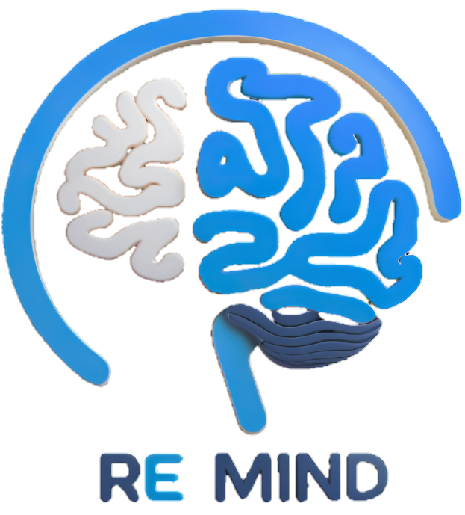
ReMind
Under Supervision of:
Dr. Shaimaa Galal
Eng. Aliaa
Mid-Year Discussion
Academic Year 2024/205
1

Slide 2
Team Members
Name | ID
Aya Mohamed Abdelrahman | 20211020
Karin Khair Abdallah Mataa | 20210292
Shimaa Amer Mohamed | 20211056
Mahmoud Sayed Abdel’aty | 20210370
Mario Malak Alabd | 20210313
Mahmoud Ali Abdelmnam | 20210371
2

Slide 3
Table of contents
01
02
03
04
05
06
Motivation
Problem Definition
Objective
Solution
Scope & Limitation
Related Work
07
08
09
ML & Location
Prototype
Technologies
3

Slide 4
02
03
04
01
05
06
Motivation
07
08
4
09

Slide 5
02
01
Motivation
Problem Definition
Alzheimer's impairs memory, challenging patients and caregivers.
Traditional care is inefficient, requiring constant supervision.
Technology boosts patient independence and reduces caregiver strain.
Emergencies can occur unexpectedly in our interconnected world.
ReMind integrates AI, tracking, and reminders for better support.
03
04
05
06
07
5
08
09

Slide 6
02
Problem Definition
01
03
04
05
06
07
08
6
09

Slide 7
Problem Definition
01
02
03
Memory-related challenges impact daily life, especially for individuals with cognitive impairments.
Forgetting important tasks, medications, or appointments can lead to serious consequences.
Existing reminder systems lack personalization and adaptability to individual needs.
Staying with a caregiver in same place all time isn’t an efficient solution.
The current landscape lacks a smart, user-friendly, and unified solution for effective memory assistance.
Objective
04
05
06
07
7
08
09

Slide 8
03
Objective
01
02
04
05
06
07
08
8
09

Slide 9

Objective
01
03
02
Our project aims to tackle these issues by:
Developing smart and adaptive reminder solutions.
Creating a comprehensive platform that supports individuals with memory challenges.
Helping users manage daily tasks, medications, and appointments efficiently.
Providing remote monitoring and assistance without requiring constant physical presence.
Track and monitor people you care about.
By Addressing these concerns, we strive to make our world safer and healthier place for everyone.
04
Solution
05
06
07
9
08
09

Slide 10
04
Solution
01
02
03
05
06
07
08
10
09

Slide 11

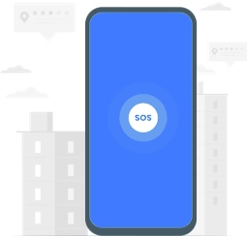

Solution
04
SOS Request
Important Dates Reminder
Medical Reminders
Patients receive reminders for medical appointments, birthdays, and important events, helping them stay connected and organized.
Automated alerts help patients take their medications on time, preventing missed doses. Caregivers get notified if a reminder is skipped.
Patients can trigger an SOS request in case of an emergency. The system will instantly notify registered caregivers, allowing them to respond quickly and provide the necessary assistance.
11

Slide 12

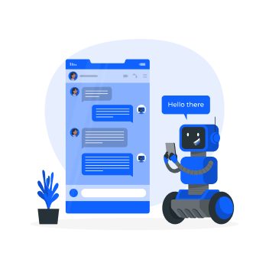
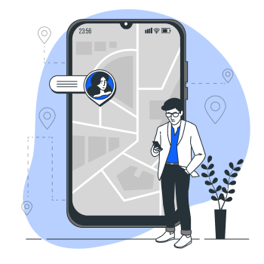
04
Solution Cont.
Memory Tests
Real time location
AI Chat bot &
Face Recognition
Caregivers can track the patient’s location in real time. Alerts are sent if the patient wanders into unsafe areas.
The AI chatbot assists caregivers with guidance, and quick answers to common concerns. Face recognition helps patients identify family members and caregivers, reducing confusion and enhancing social interactions.
Engaging memory games help stimulate cognitive function and slow decline, while also tracking the patient’s progress over time.
12

Slide 13

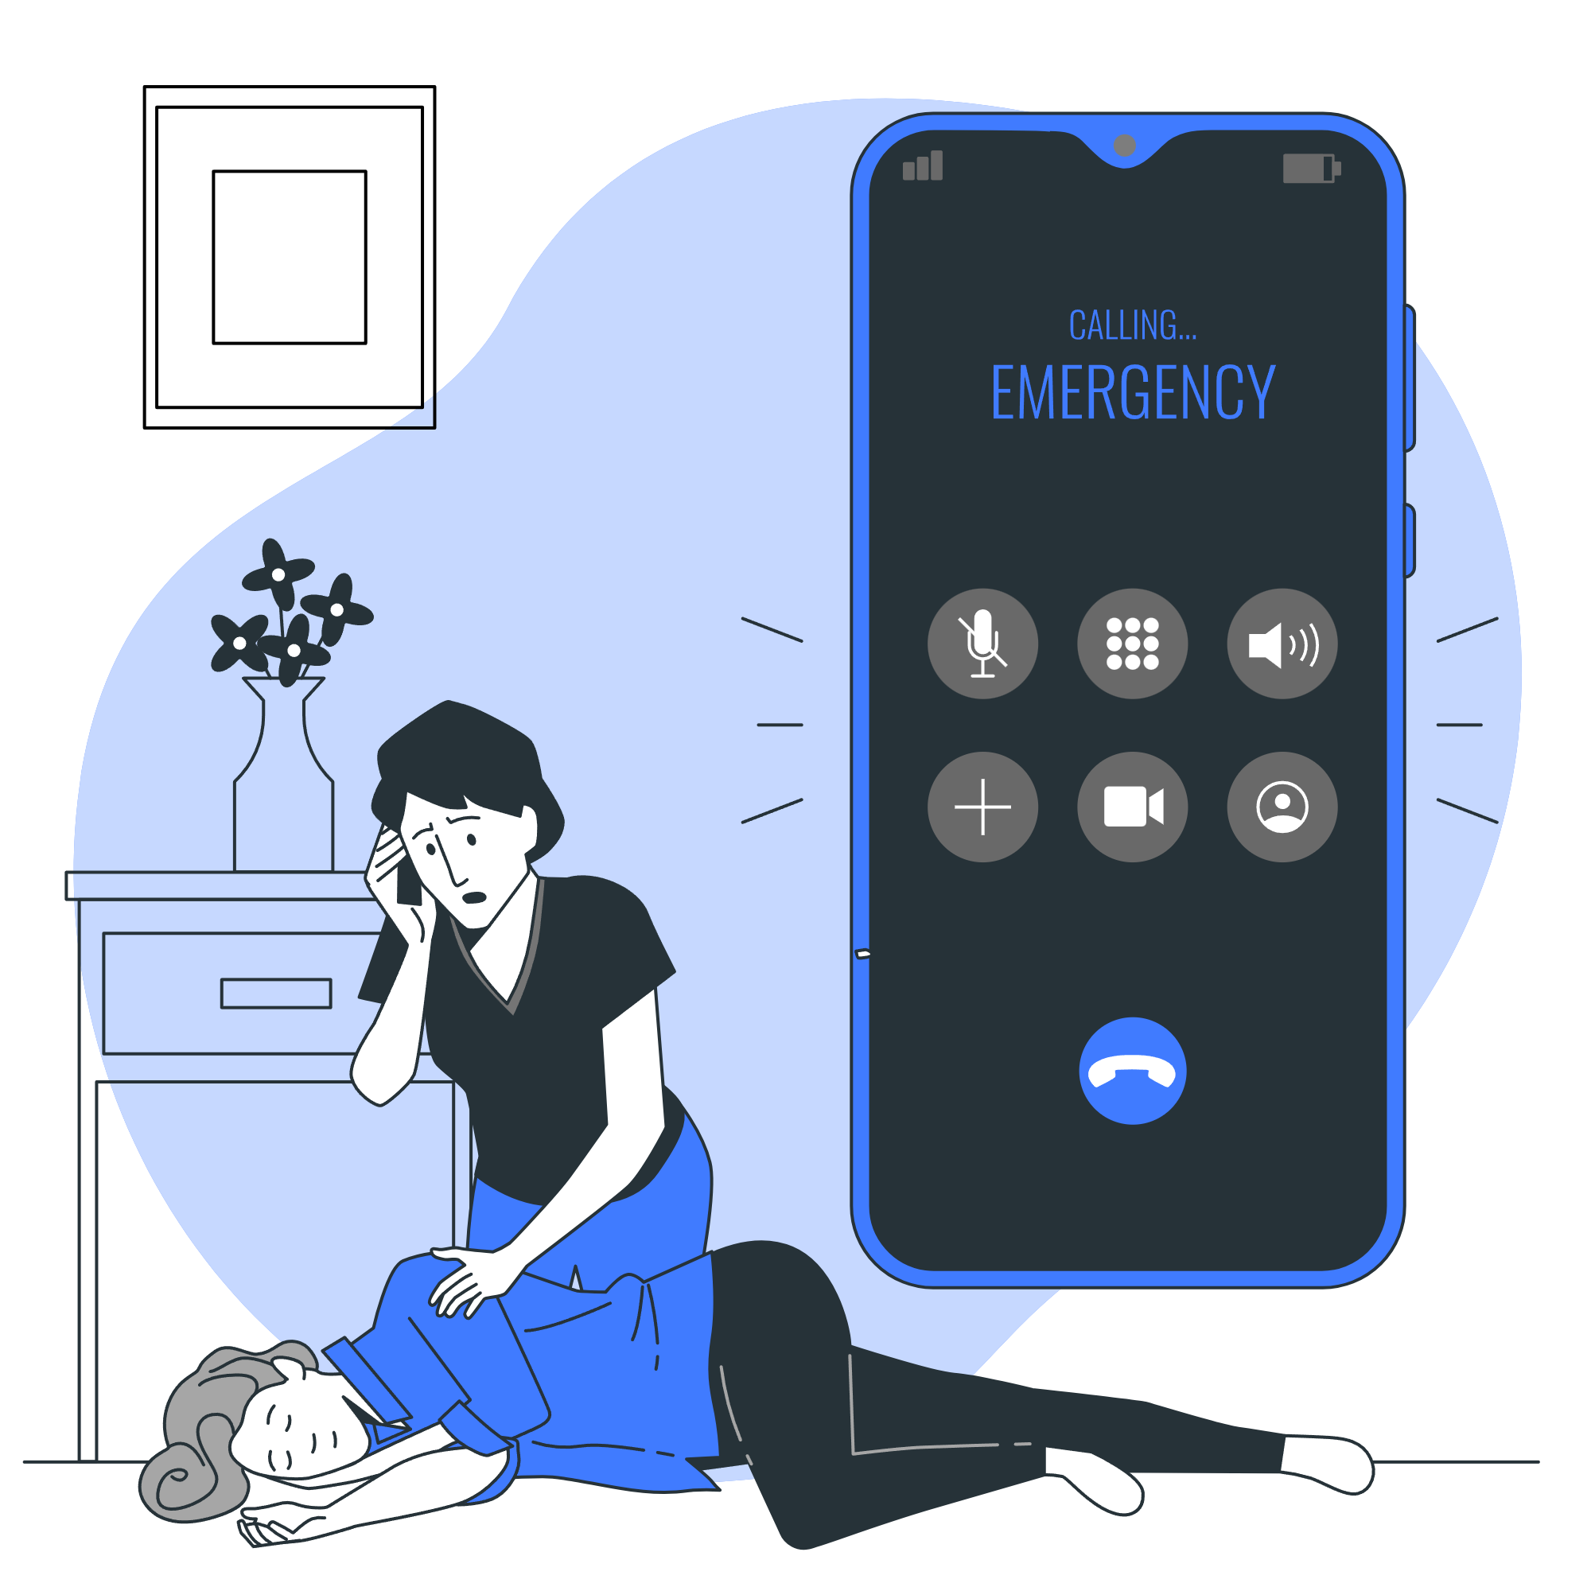

Scope & Limitation
01
04
Solution Cont.
02
03
05
Safe Zone & Boundary Alerts
Community Support &
Educational Resources
Emergency Contacts
The caregiver can define a geographical safe zone. If the patient wanders outside this area, an immediate alert is sent to caregivers, helping prevent disorientation or dangerous situations.
Caregivers can access a support network, share experiences, and find expert guidance. Educational resources provide insights on managing Alzheimer’s, improving care, and enhancing daily life.
A quick-access list of emergency contacts allows patients or caregivers to call for help instantly when needed.
06
07
13
08
09

Slide 14
05
Scope & Limitation
01
02
03
04
06
07
08
14
09

Slide 15
05
Scope
The project scope specify the functionality of each user in our app:-
Patient:
Receive medication reminders
Access memory training exercises
Use face recognition to identify people
Trigger emergency actions to alert caregivers.
Caregiver:
Monitor the patient’s real-time location.
Set medical and appointments reminders.
Control safe zones for the patient
Interact with a chatbot to receive caregiving tips, support.
Admin:
Add educational resources to the community.
Monitor overall system usage.
Send announcements and updates for the users
15

Slide 16
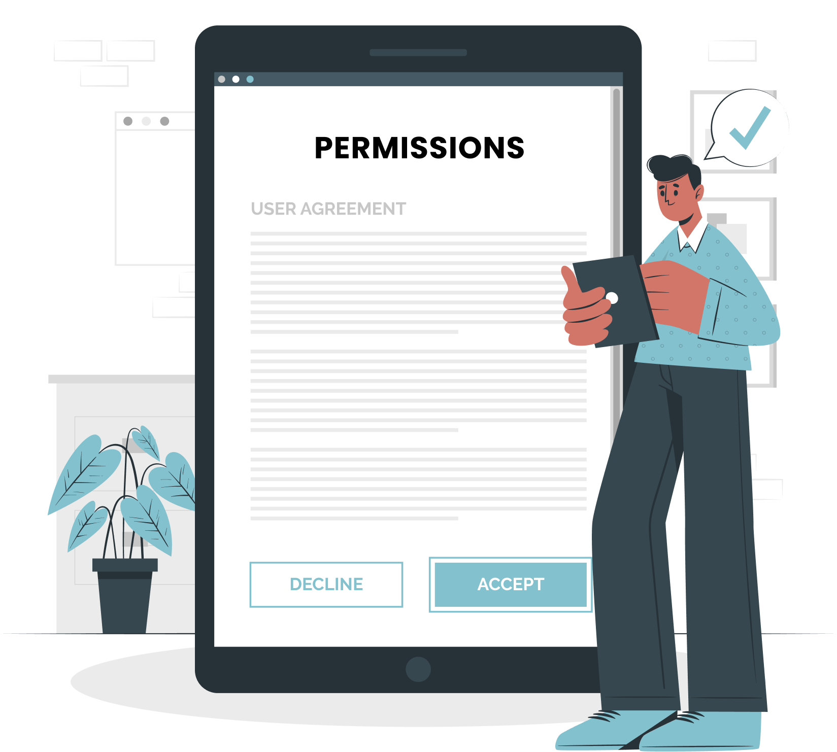
Related Work
01
05
Limitations
02
Location Tracking: Requires user permission and a stable internet connection. Accuracy depends on device, network, and GPS quality.
Patient Responsibility: Must confirm medication intake and stay connected to the internet for tracking and alerts.
Caregiver Responsibility: Must set safe zones, respond to SOS alerts, and ensure a stable internet connection for real-time notifications
03
04
06
07
16
08
09

Slide 17
06
Related Work
01
02
03
04
05
07
08
17
09

Slide 18
06
Related Work
Feature | ReMind | Alz better | Alz Connected | Alzheimer’s App | CaringBridge | Life360 | Care Partner
Symptom tracking | _ | _ | _ | ✔ | _ | _ | _
Reminders for medication | ✔ | _ | _ | _ | _ | _ | ✔
Cognitive Tests | ✔ | _ | _ | _ | _ | _ | _
Community support | ✔ | ✔ | ✔ | _ | ✔ | _ | _
18
 | Not mainly focused on Alzheimer
 | Exclusive feature for ReMind

Slide 19
06
Related Work Cont.
Feature | ReMind | Alz better | Alz Connected | Alzheimer’s App | CaringBridge | Life360 | Care Partner
Location tracking | ✔ | _ | _ | _ | _ | ✔ | _
AI face recognition | ✔ | _ | _ | _ | _ | _ | _
Safe zone boundaries | ✔ | _ | _ | _ | _ | _ | _
Personalized resource library | ✔ | _ | _ | ✔ | _ | _ | _
19
 | Not mainly focused on Alzheimer
 | Exclusive feature for ReMind

Slide 20
ML & Location
01
06
Related Work Cont.
02
ReMind's Unique Value: Clearly stands out with exclusive features like Cognitive Tests, AI Face Recognition, and Safe Zone Boundaries, directly addressing Alzheimer's caregiving needs.
Targeted Audience Focus: Unlike competitors, ReMind is specifically designed for Alzheimer's caregivers, ensuring tailored support.
Comprehensive Care Solution: Combines essential features like reminders, location tracking, and community support, making it a holistic caregiving tool.
Competitive Advantage: Competitors either lack Alzheimer's-specific focus or miss critical features, positioning ReMind as the most relevant solution.
03
04
05
07
20
08
09

Slide 21
07
ML & Location
01
02
03
04
05
06
08
21
09

Slide 22
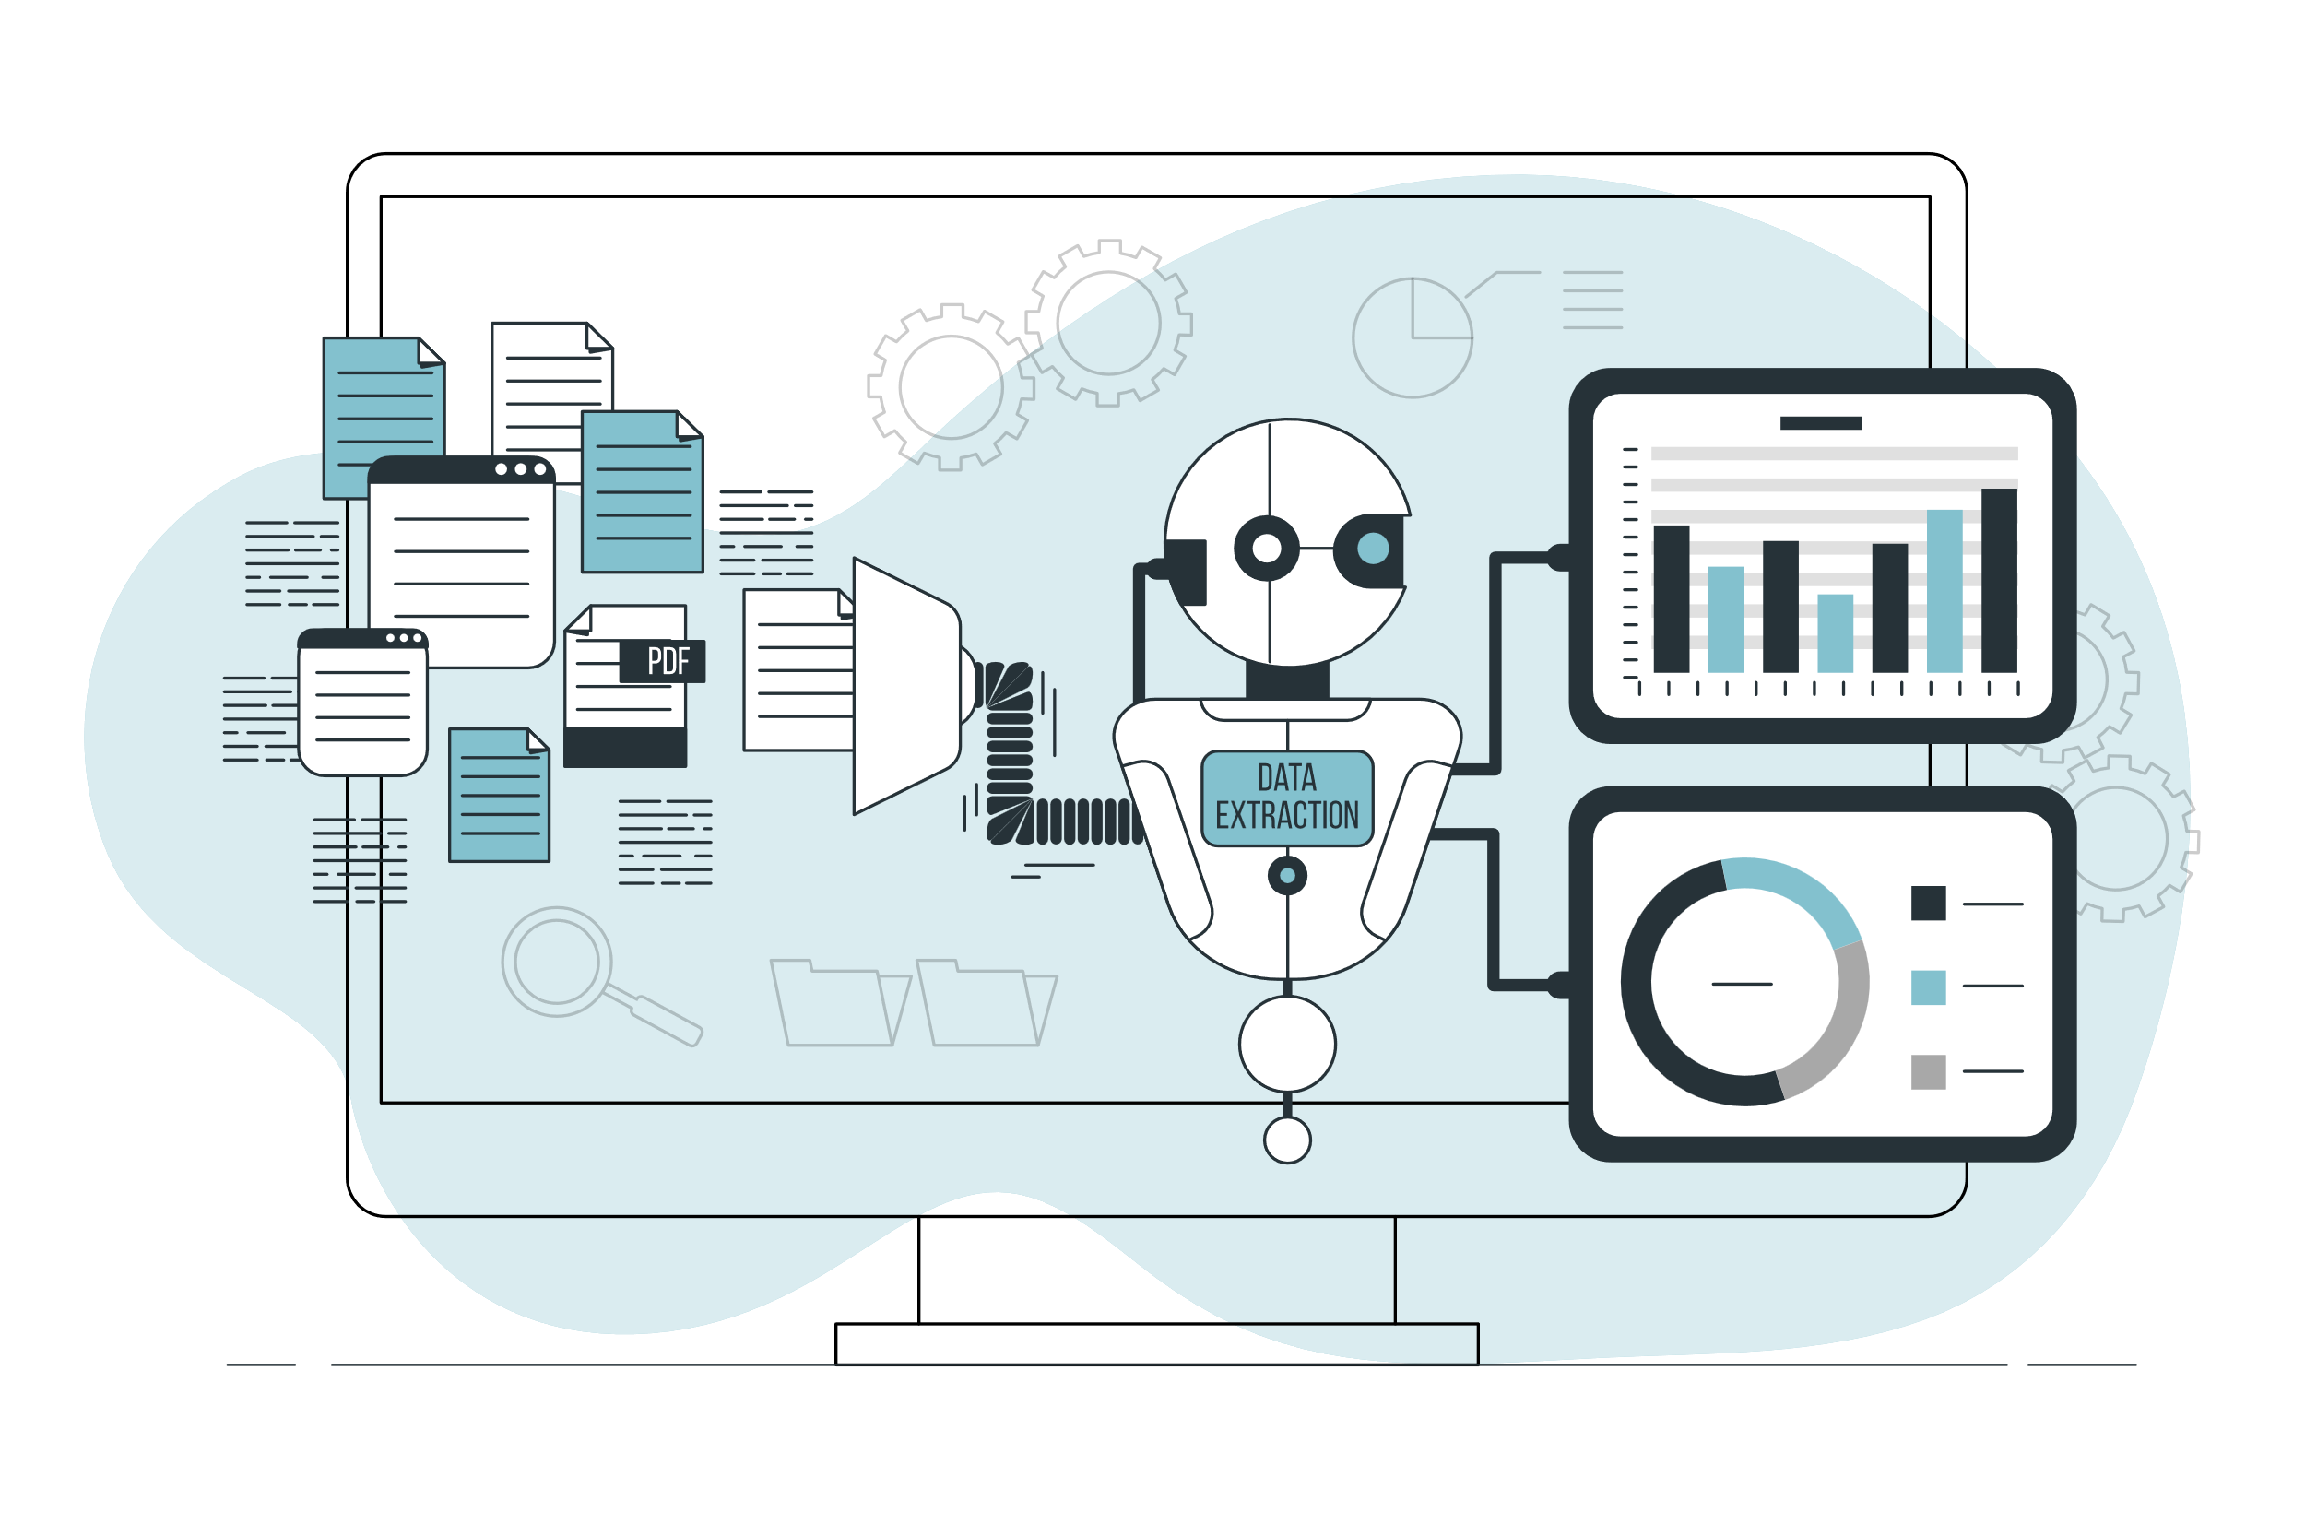
07
Machine Learning
Our feature: Face recognition
Used Algorithm: Neural network (NN)
Dataset: Consisting of general and custom photos for each patient.
Visualization: Details about the recognized person.
Benefits:
Real-Time Updates.
Personalized Assistance
Accurate Identification.
22

Slide 23
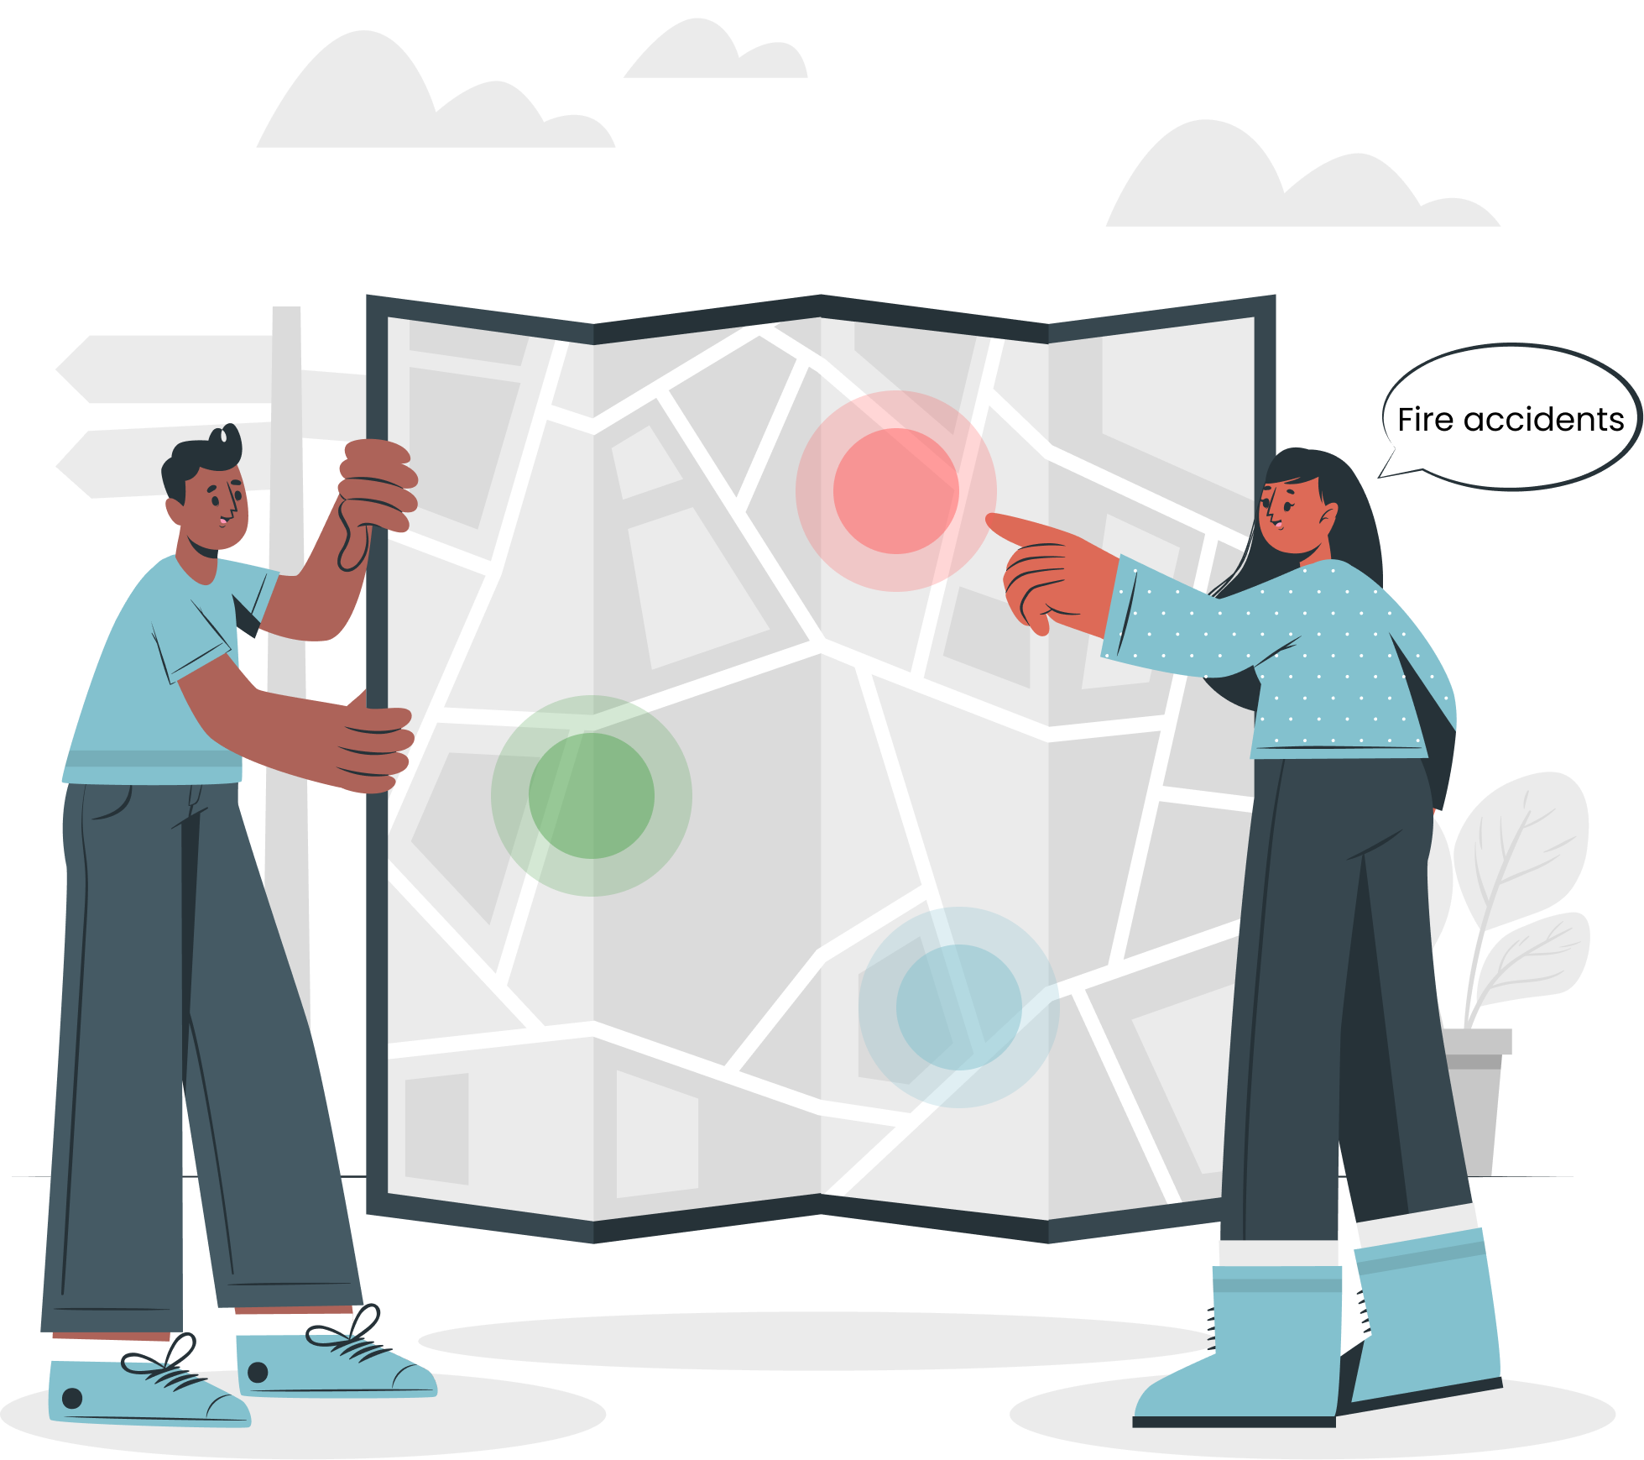
07
Location System
01
02
Our feature: Location tracking & Safe zone boundaries
Used Algorithm: point in polygon (PIP)
Used technologies:
Google maps APIs
Socket.io
Visualization: Google maps
Benefits:
Real-Time tracking.
Safe zone breach notification.
03
04
05
06
08
23
Prototype
09

Slide 24
08
Prototype
01
02
03
04
05
06
07
24
09

Slide 25
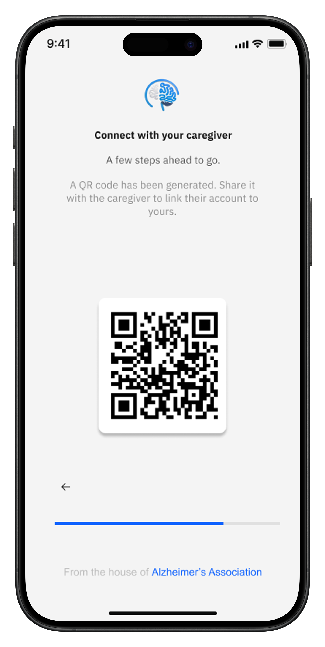
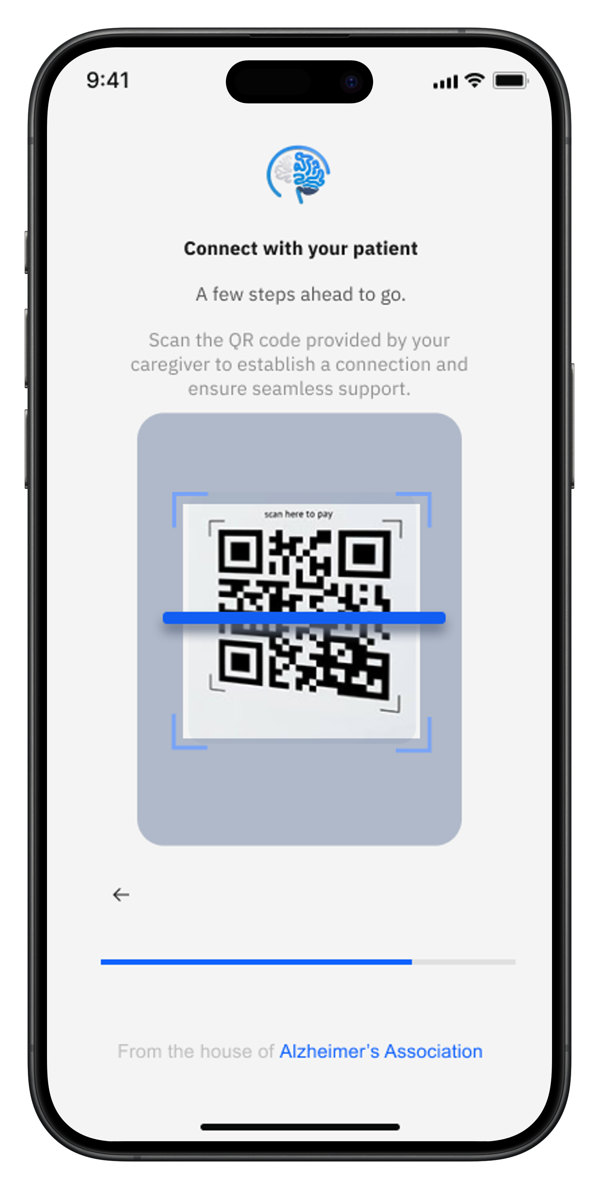
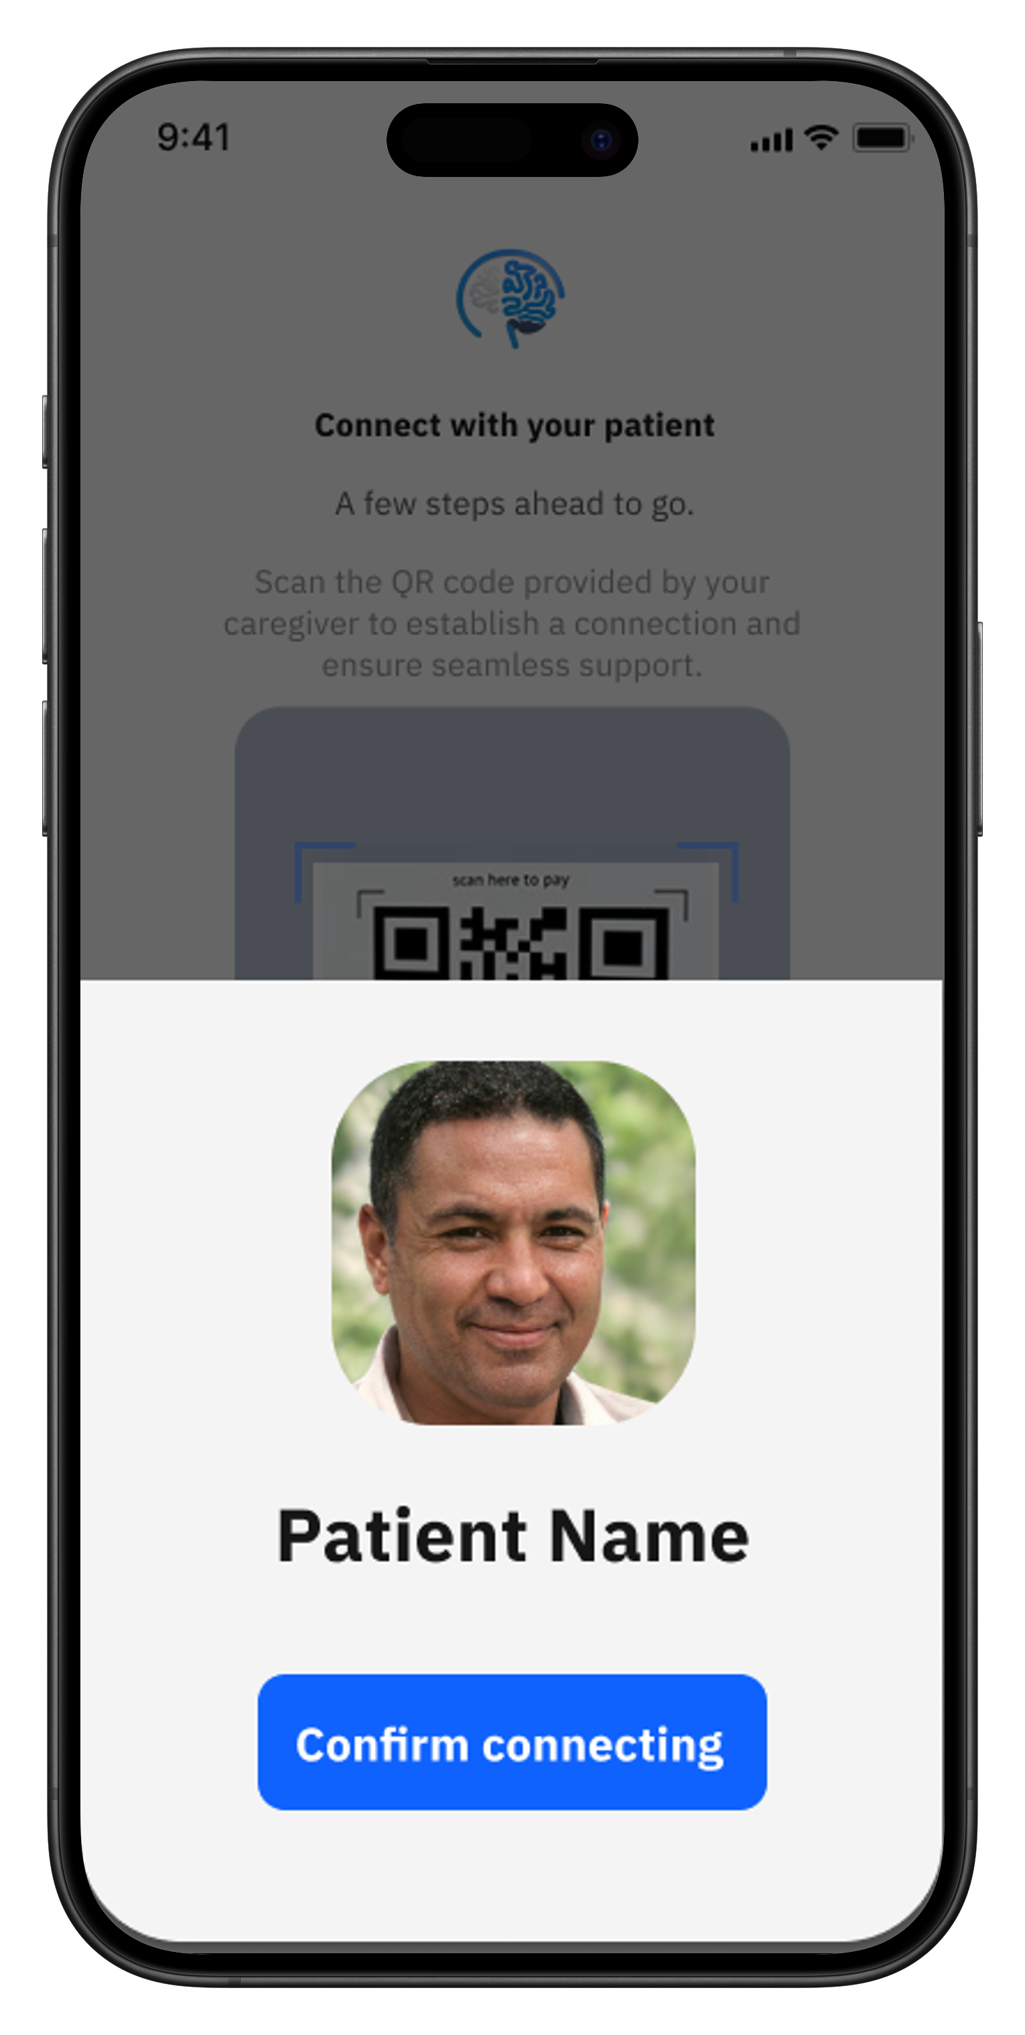
Linking Patient with caregiver
Patient App
Caregiver App
25

Slide 26
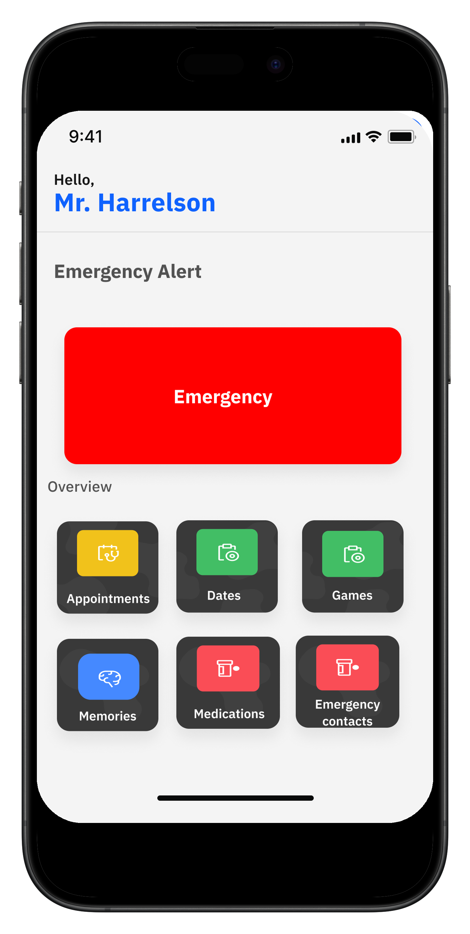
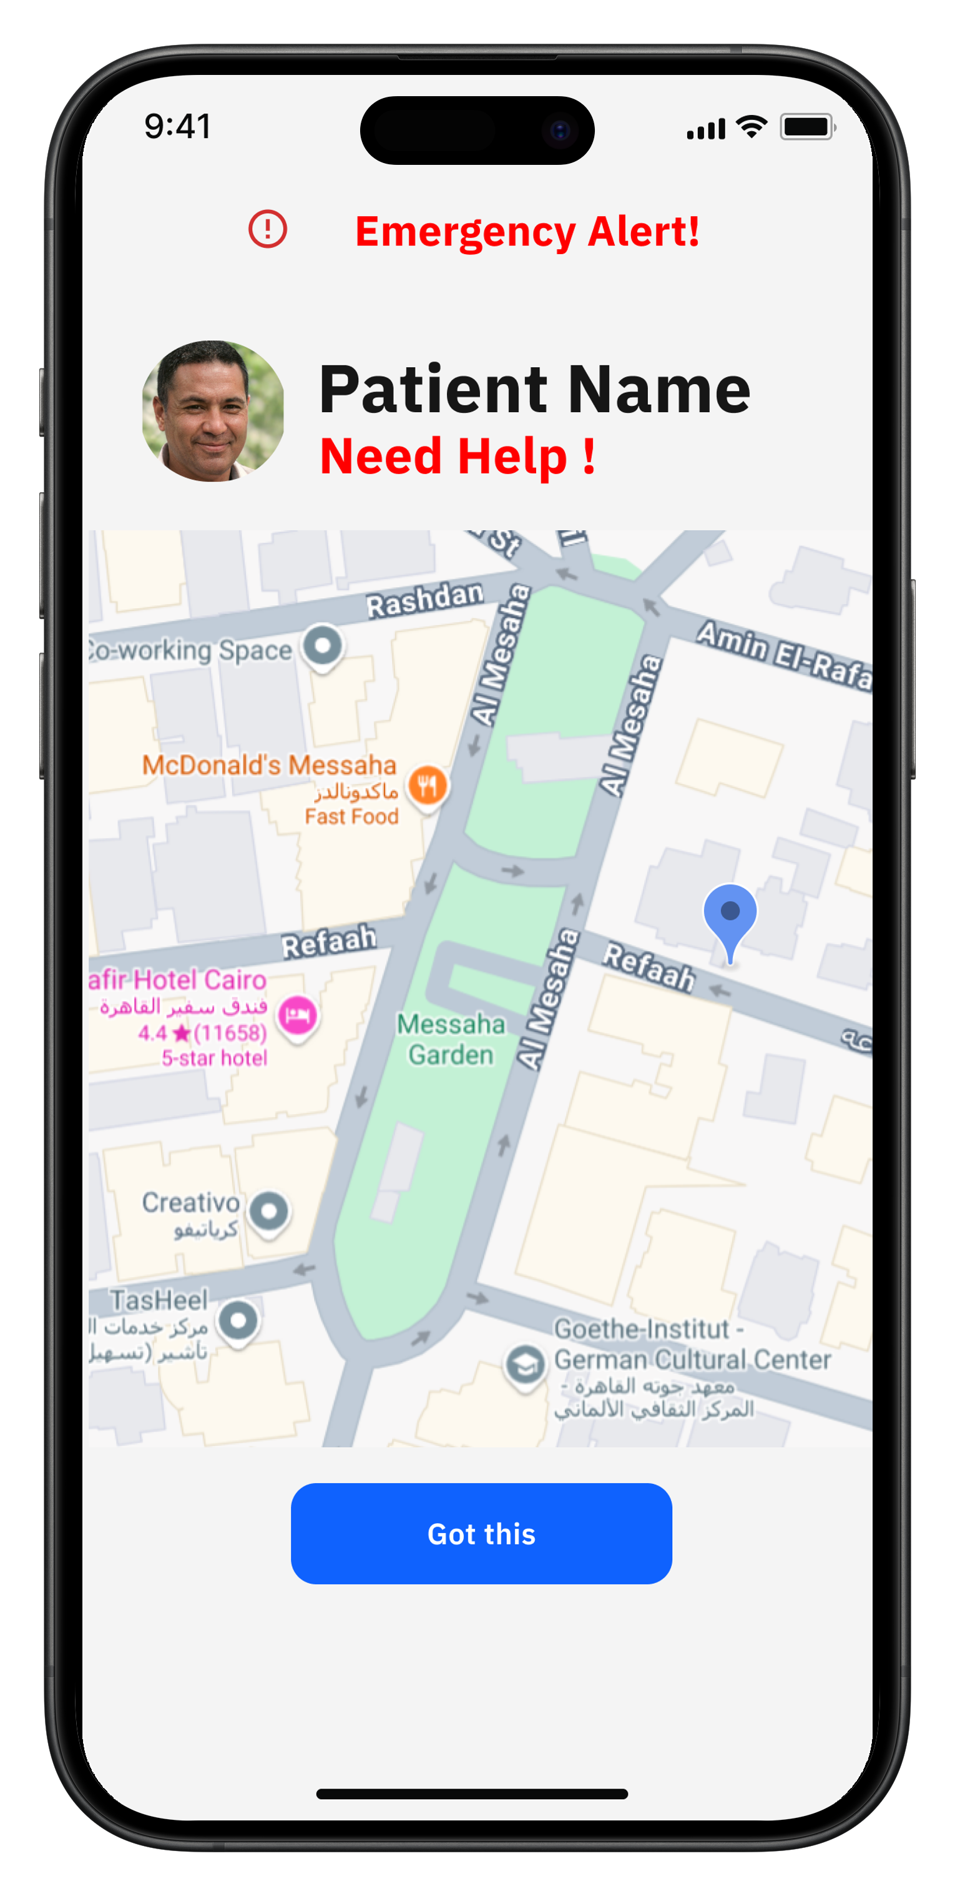
Emergency Request (SOS)
Patient App
Caregiver App
26

Slide 27
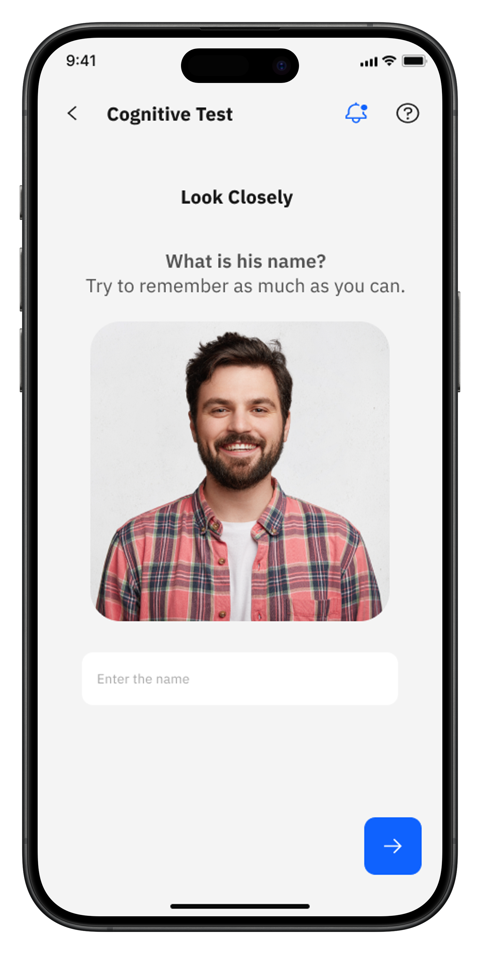

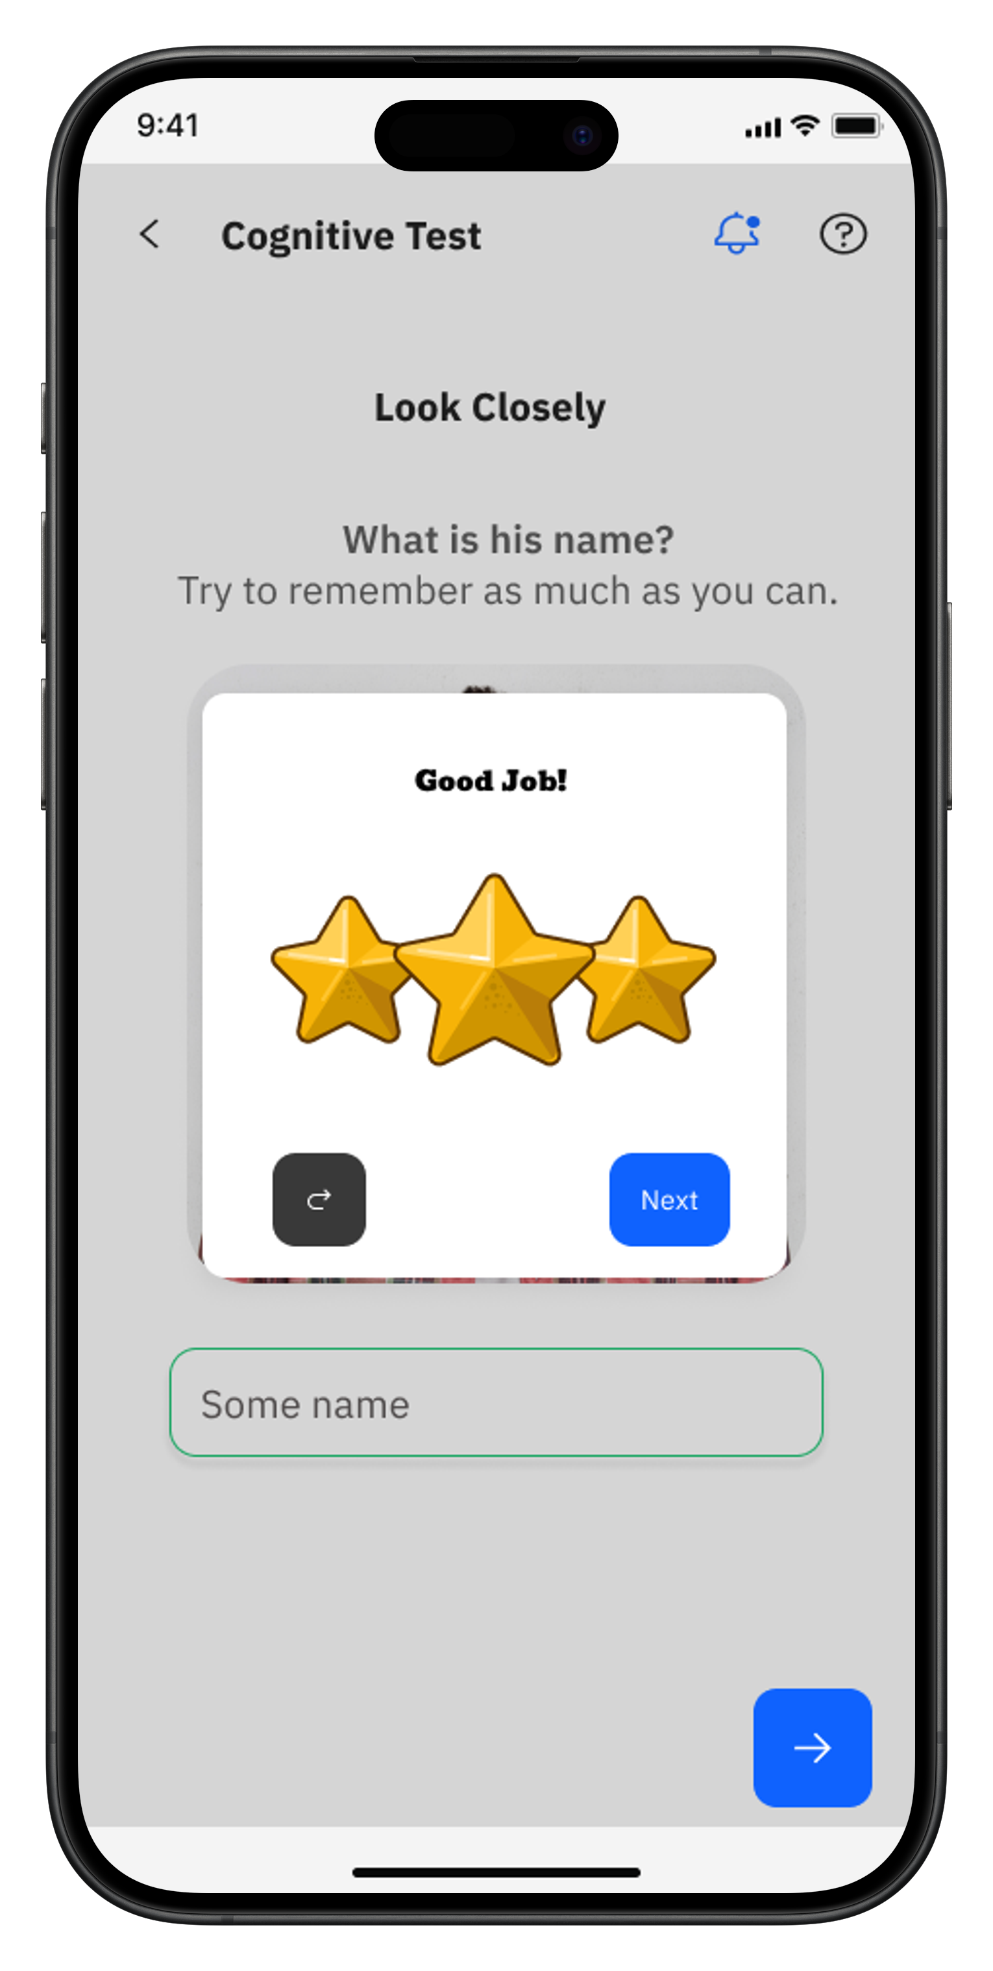
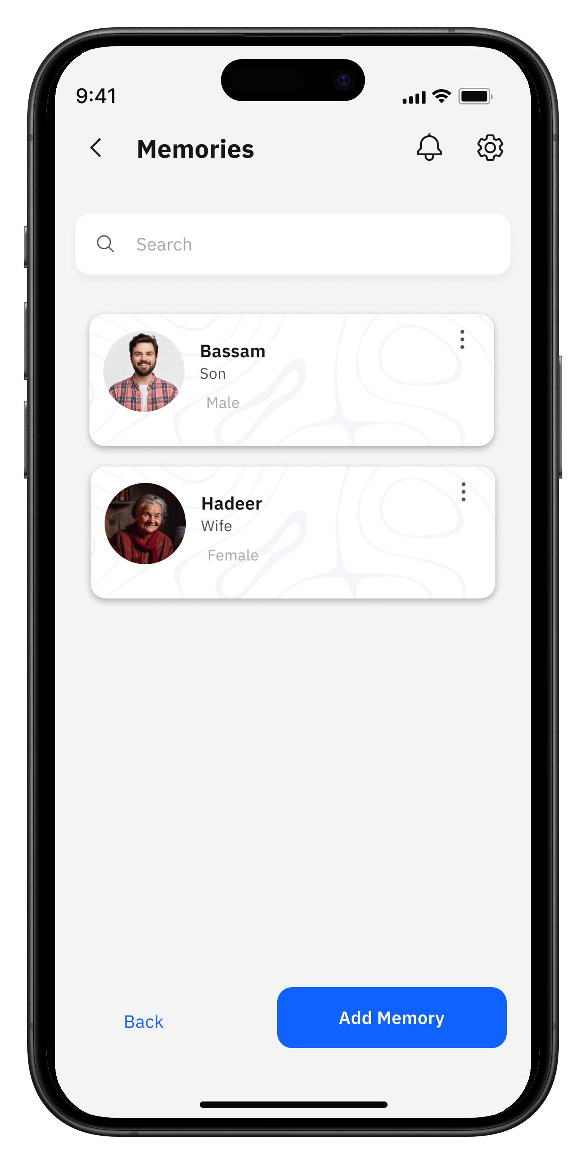
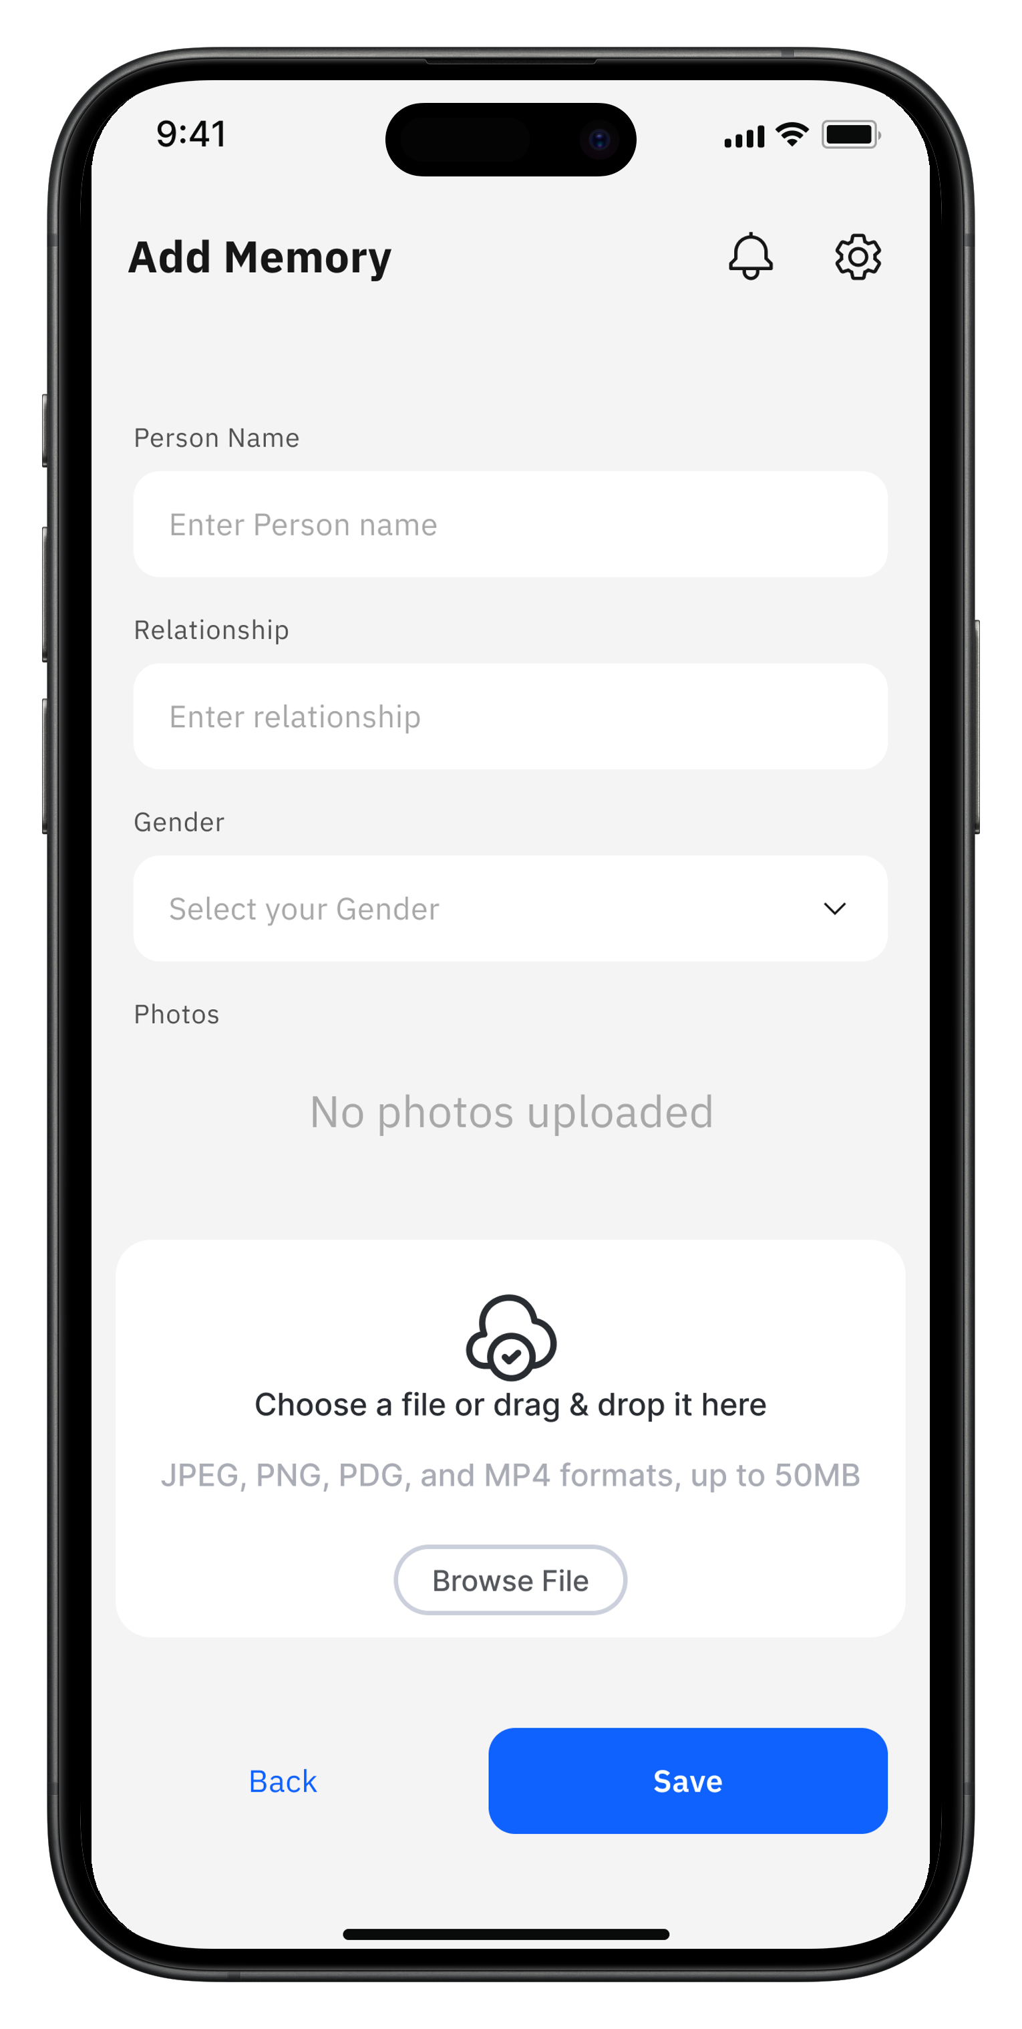
Memory Test
Patient App
Caregiver App
27

Slide 28
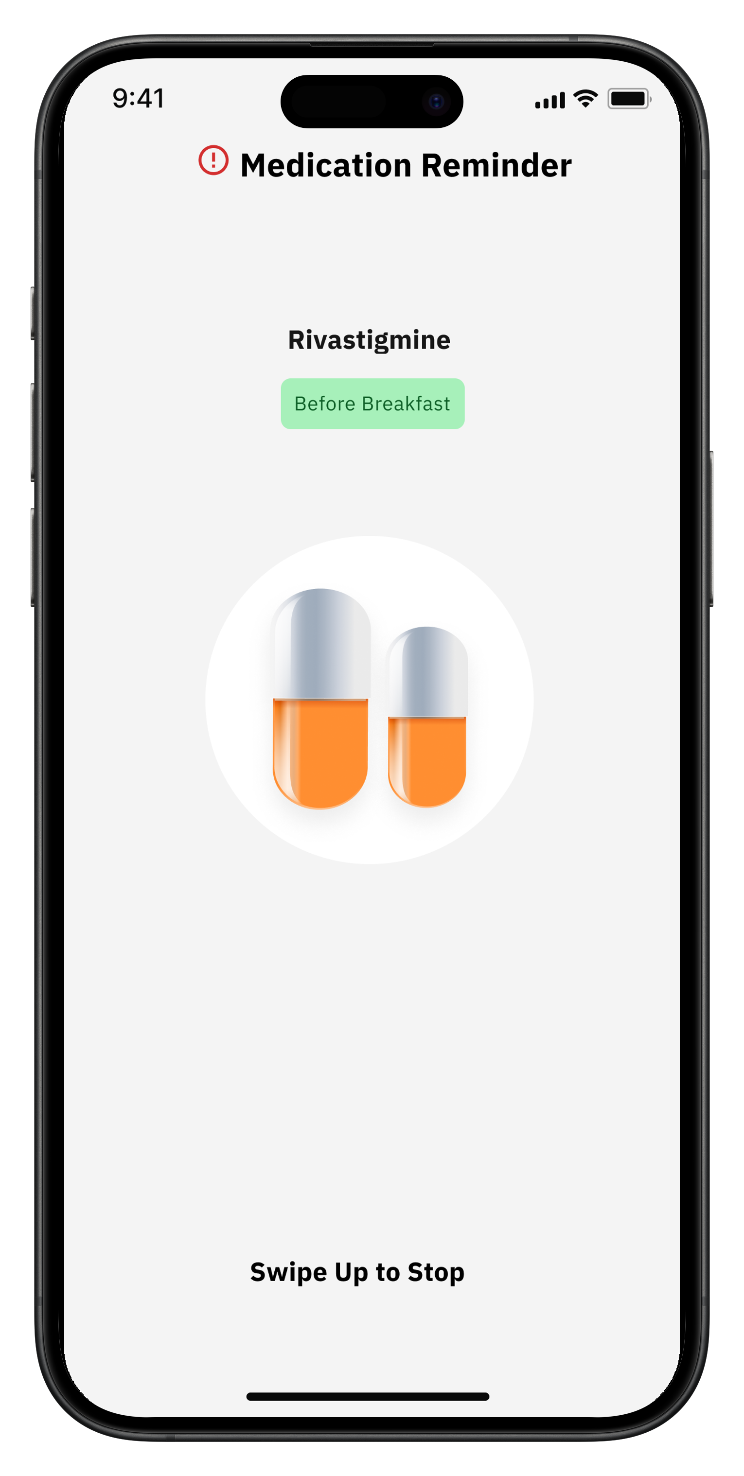
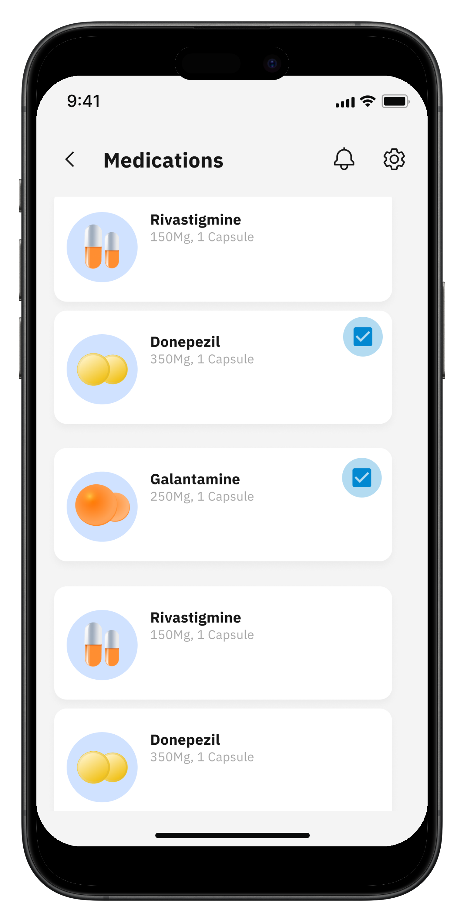
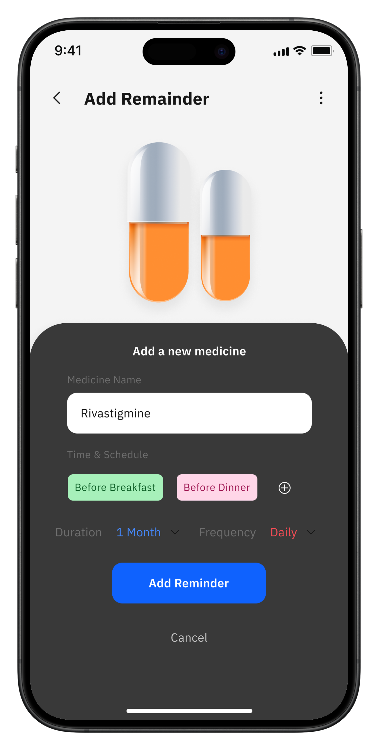
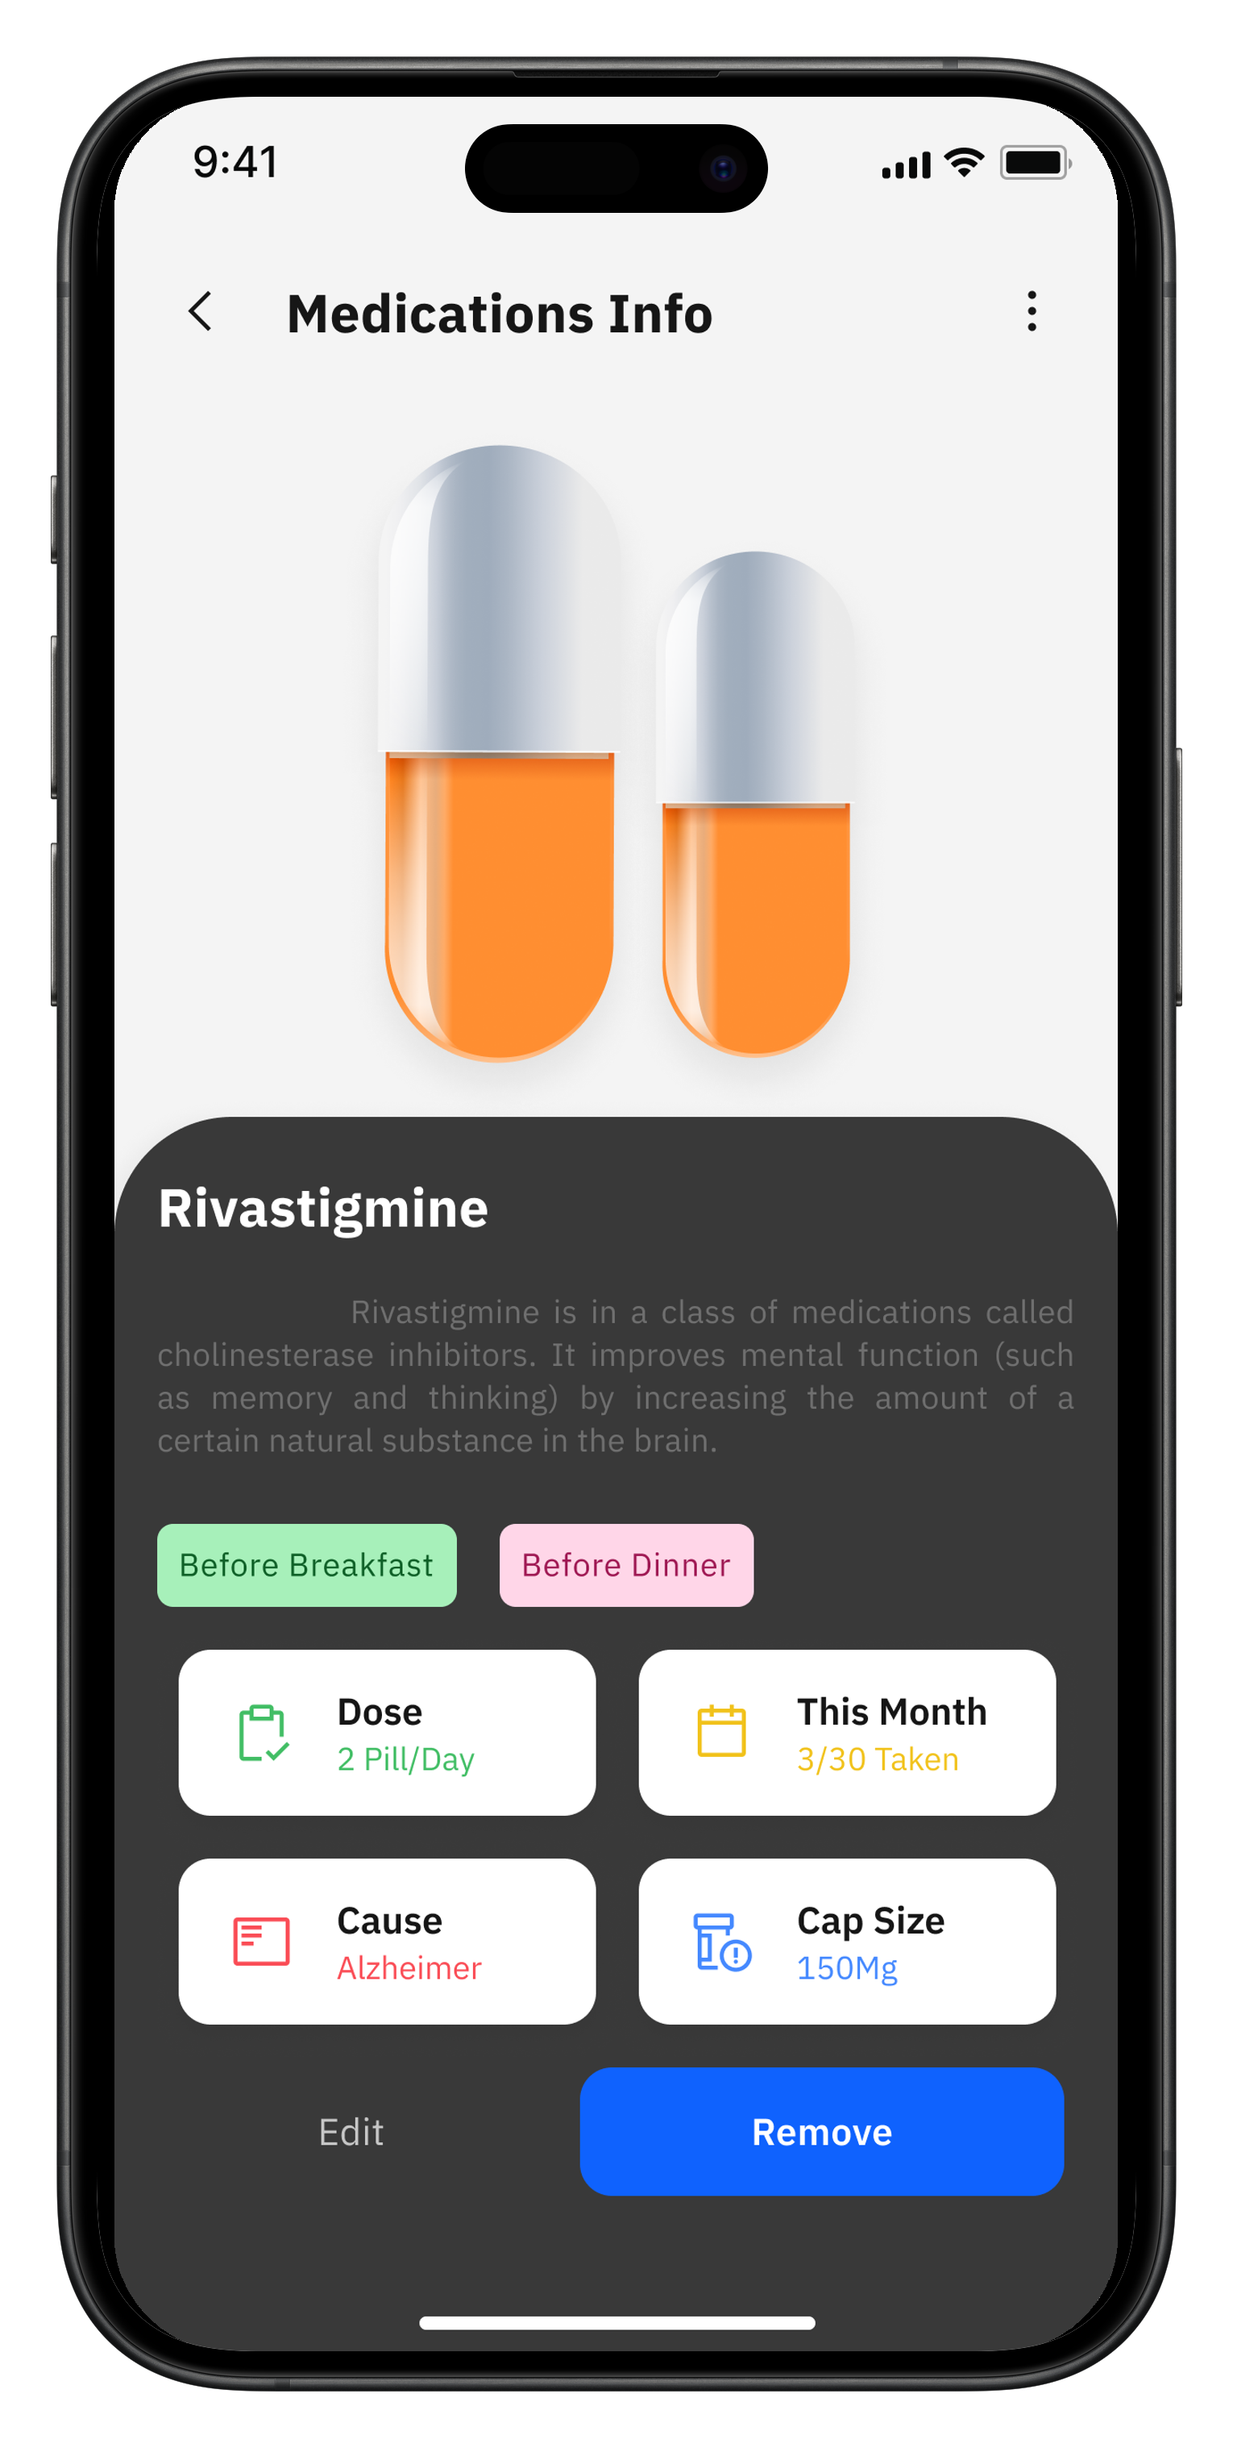
Medicine Reminder
Patient App
Caregiver App
28

Slide 29
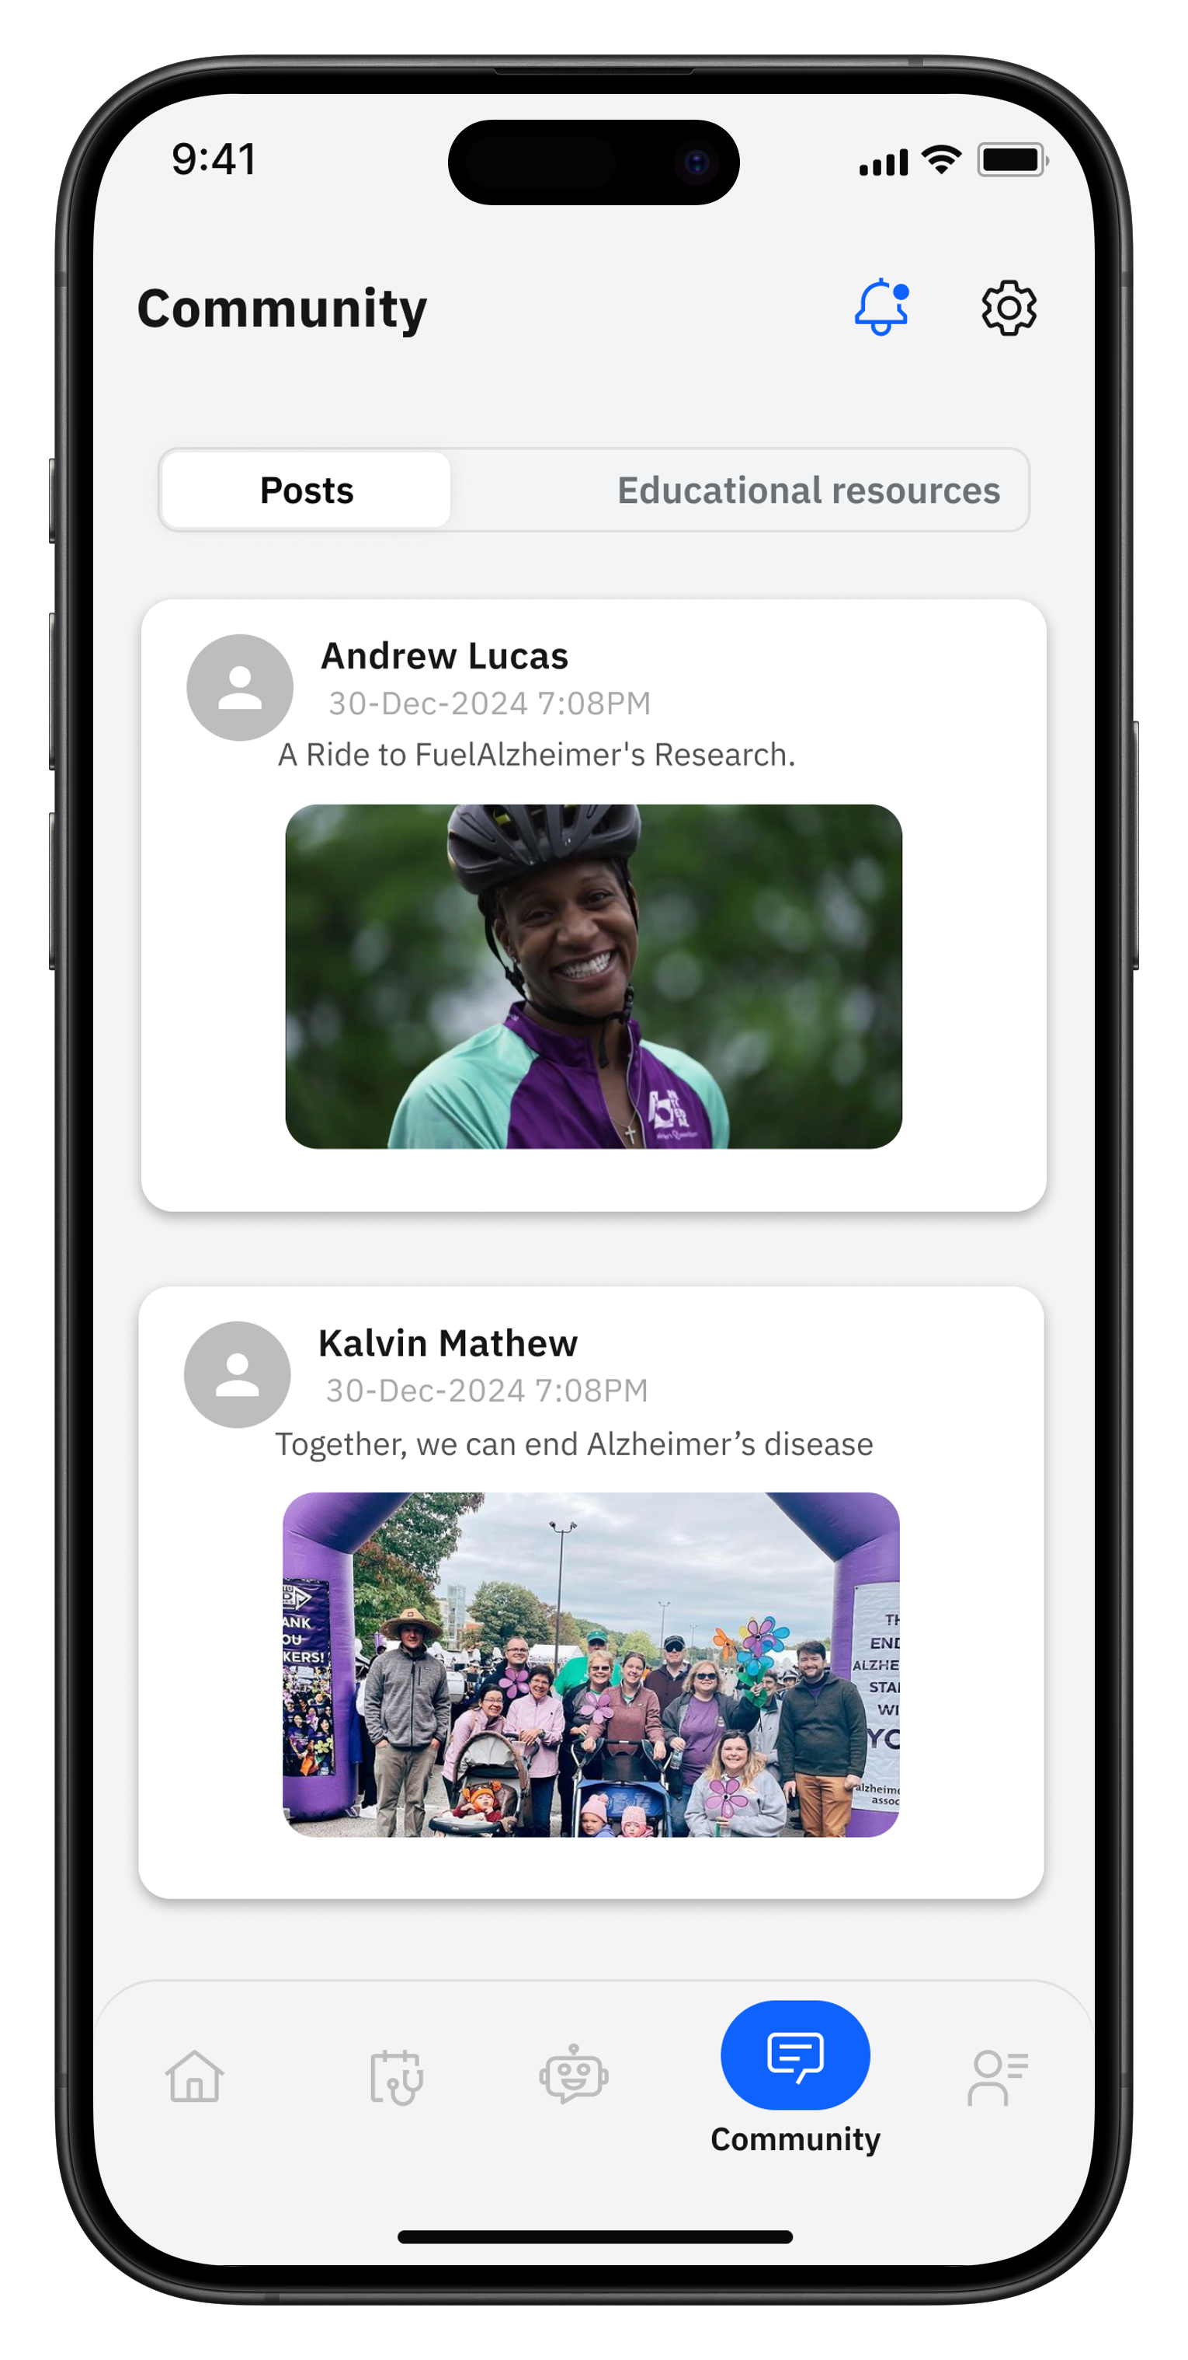
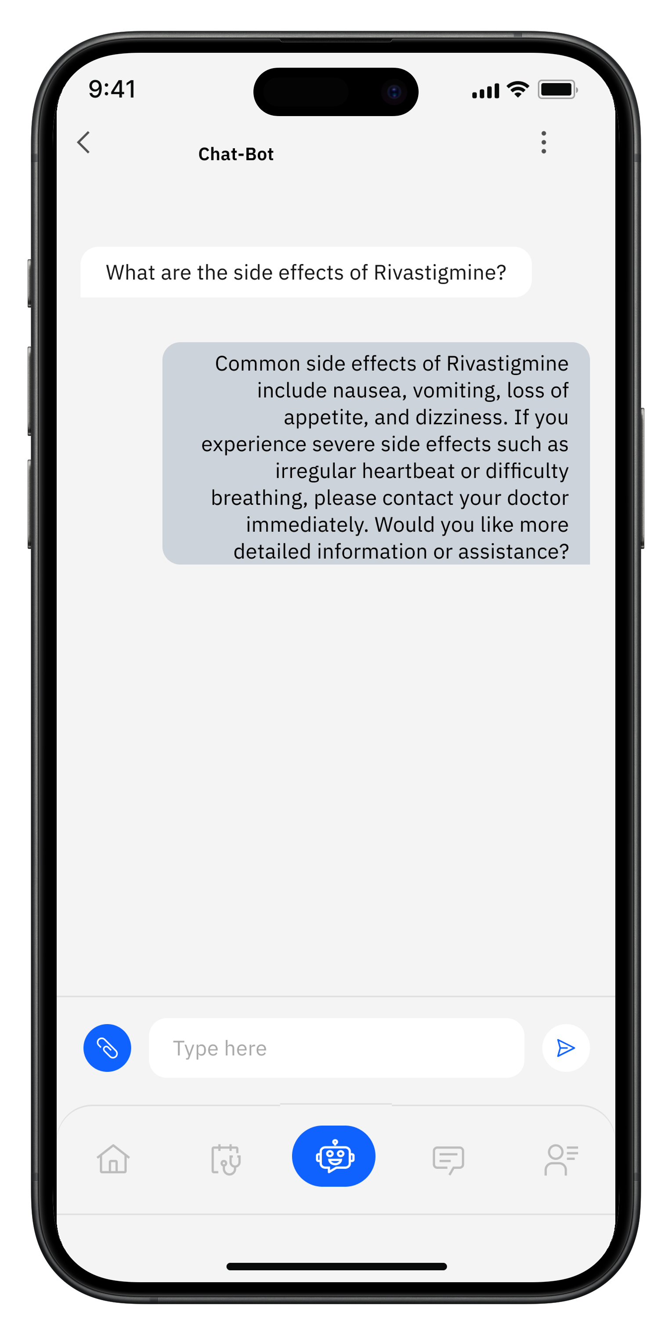
Community & AI Chatbot
Patient App
Caregiver App
29

Slide 30
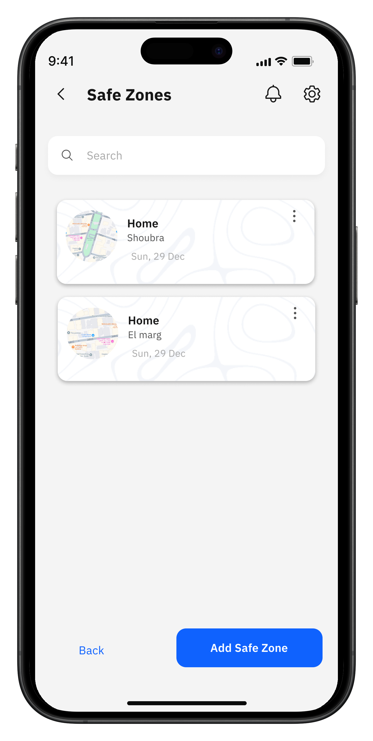
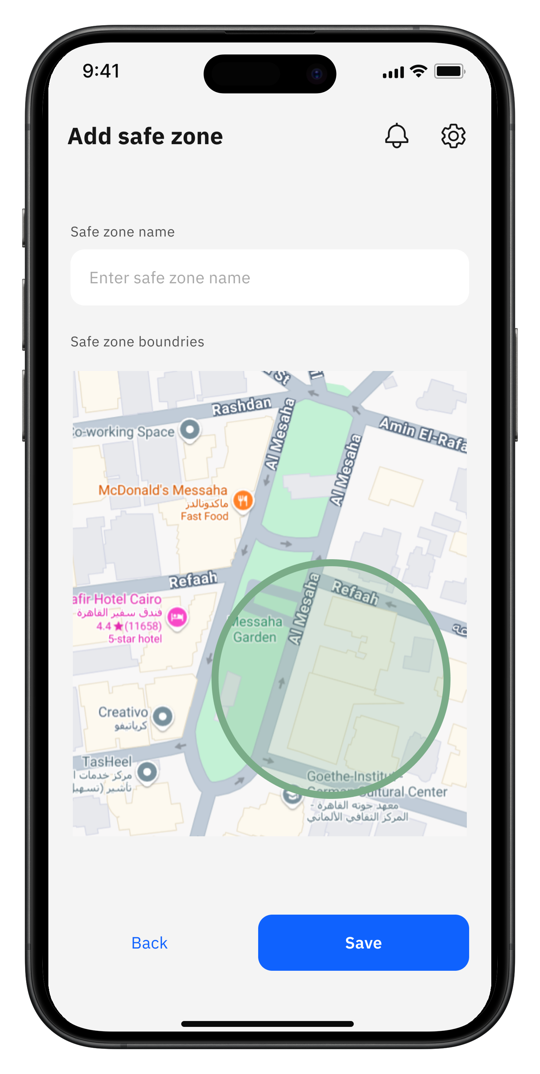
Safe Zones
Caregiver App
30

Slide 31
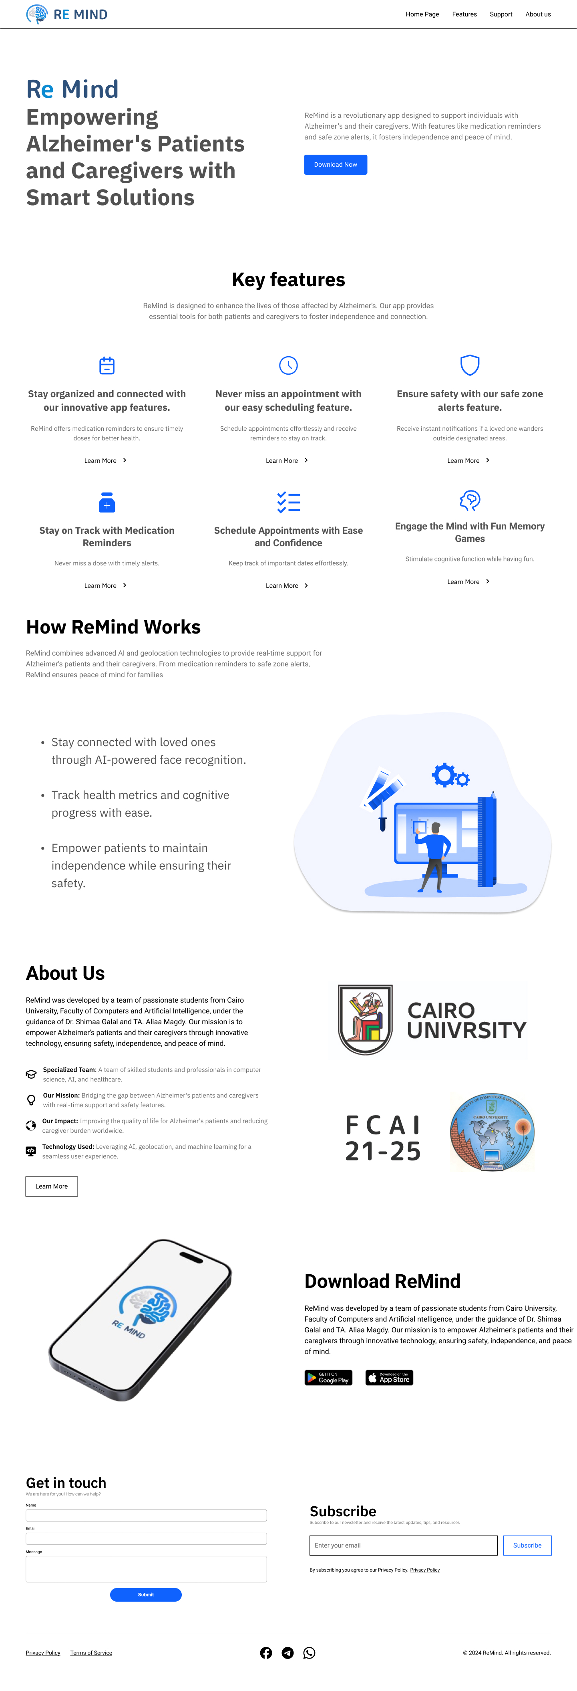
Landing website
31

Slide 33
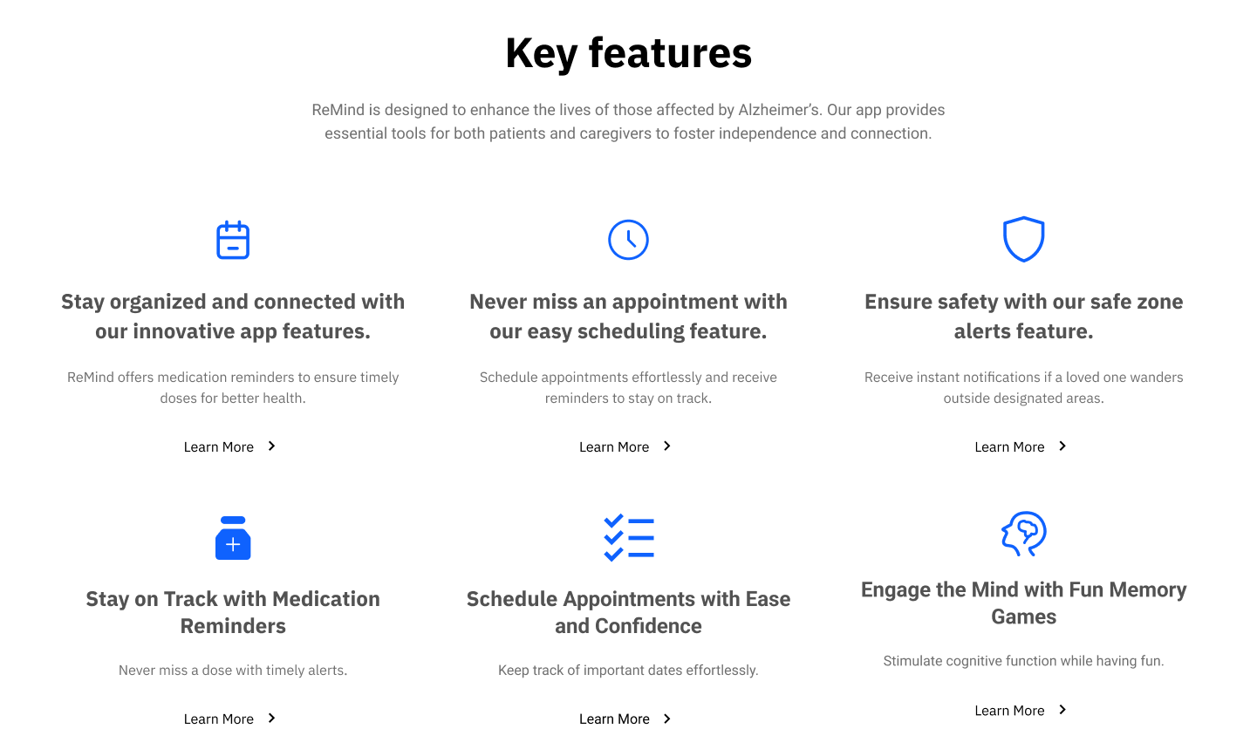
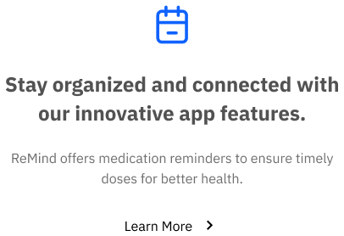
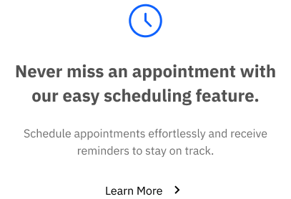
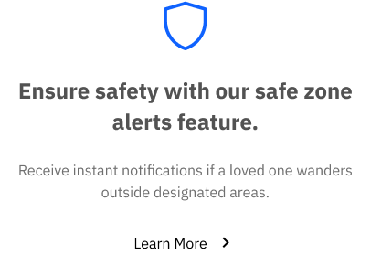
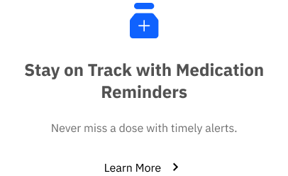
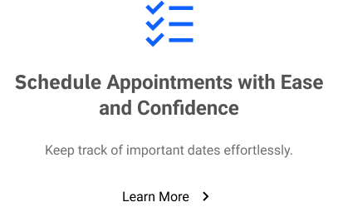
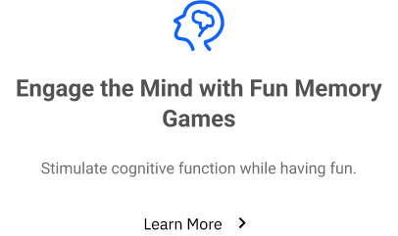

Slide 34
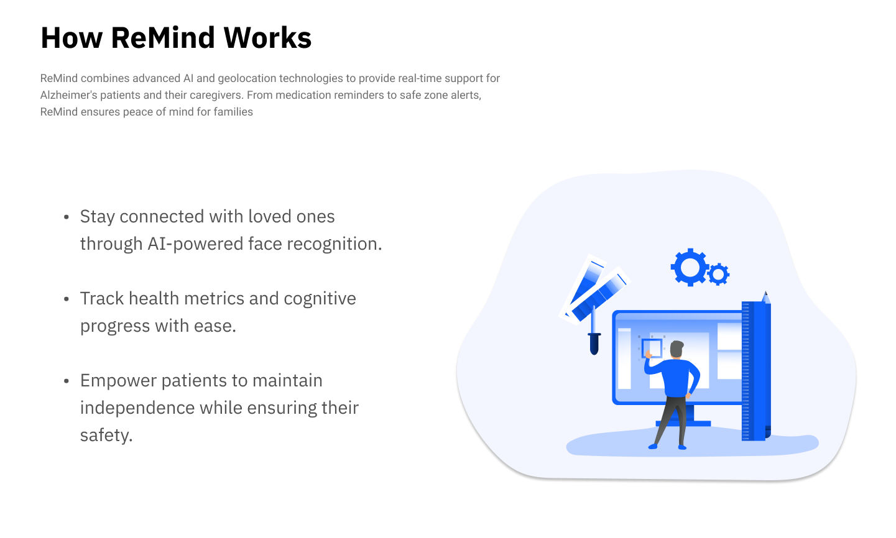

Slide 35
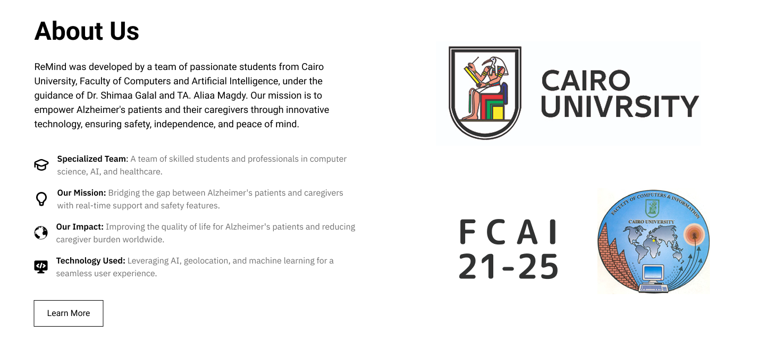

Slide 36
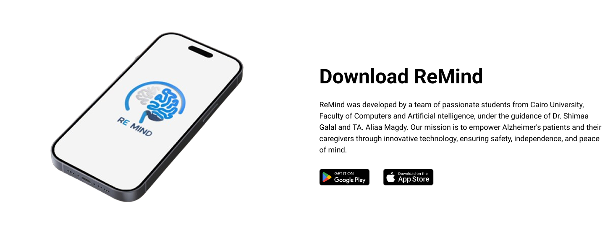

Slide 37
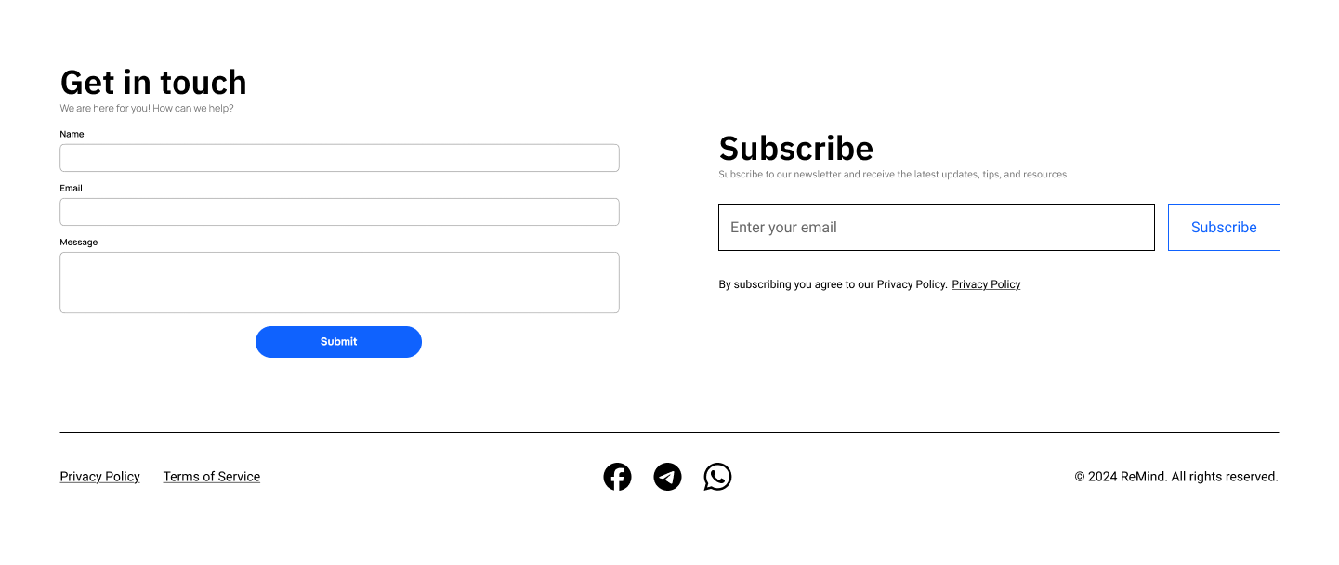
01
02
03
04
05
06
07
09
Technologies

Slide 38
09
Technologies
01
02
03
04
05
06
07
38
08

Slide 39


09
Technologies
Flutter
Next.JS
Modern UI toolkit for building cross-platform applications from a single codebase.
It provides a rich set of pre-built widgets, fast performance, and a reactive framework for building dynamic user interfaces.
Popular React framework for building interactive user interfaces.
It promotes the use of reusable components and server-side rendering for efficient performance and seamless experience.
Frontend
39

Slide 40


09
Technologies Cont.
Express.JS
Flask
Express.js is a server-side JavaScript framework designed for building scalable and fast web applications.
It is used in this project to handle real-time operations, such as
sending notifications and managing user sessions.
Flask is a lightweight Python web framework ideal for creating robust back-end services and APIs.
It is used in this project to handle operations with the model and
AI-based requests.
Backend
40

Slide 41


09
Technologies Cont.
MongoDB
MySQL
NoSQL database designed for scalability and flexibility
Used to store real-time location data efficiently.
Allows fast retrieval and updates.
Relational database known for reliability and consistency.
Manages structured data with data integrity.
Supports complex queries and relationships.
Database
41

Slide 42



09
Technologies Cont.
Git
GitHub
It enables developers to:
Track changes to the codebase.
Revert to earlier versions when needed
GitHub is cloud-based hosting services for git repositories.
It provides remote collaboration feature
Version Control
42

